Slide 1
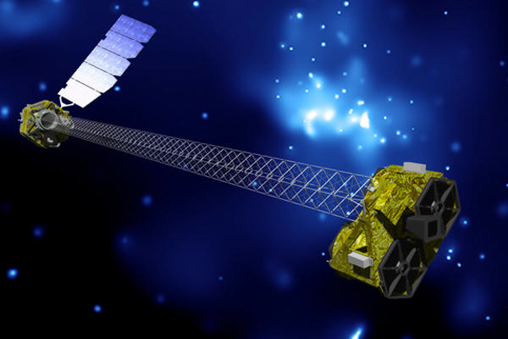
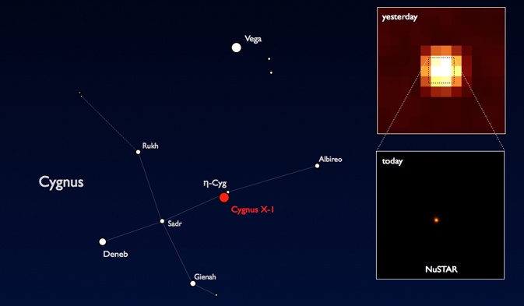

NuSTAR: 1st focussing hard X-ray Telescope
Victoria Kaspi, McGill University
IAU Symposium 291 Friday Aug 24, 2012 Beijing, China

Slide 2
Why Hard X-rays?
Relatively unexplored region of spectrum
Unaffected by photoelectric absorption, either in Galaxy or intrinsic
Studies of non-thermal emission above where thermal X-rays ‘contaminate’
Radioactive decay lines (e.g. 44Ti)

Slide 3
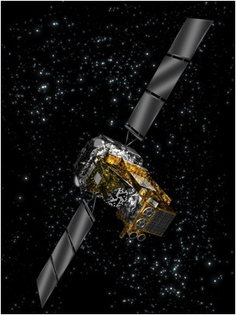
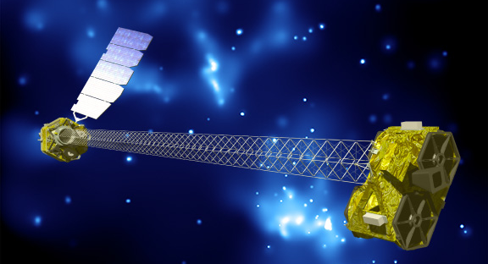
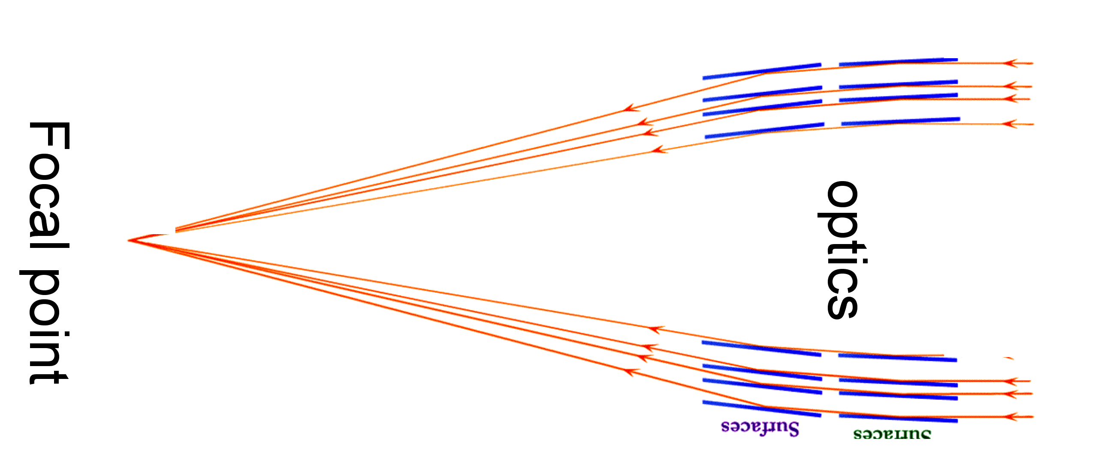
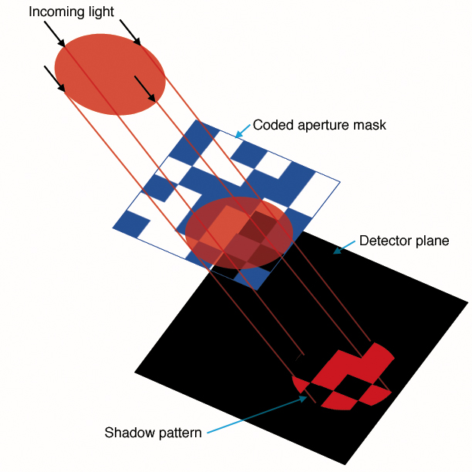
INTEGRAL, Swift BAT
NuSTAR
Coded Mask
Focal spot
Grazing incidence
optics
Wolter Type 1
E.g. IBIS on INTEGRAL: 12’ FWHM

Slide 4
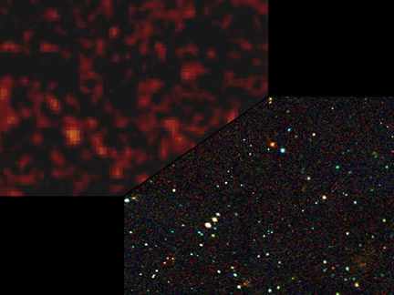
NASA’s NuSTAR
First focusing hard X-ray telescope
NASA SMEX $165M
Wolter-1 optics coated with multilayers
10 m focal length
CdZnTe detectors
Time resolution ~2 us
Energy range 5-80 keV
Spectral resolution 1@60keV
8’ FoV; ~10” FWHM

Slide 5
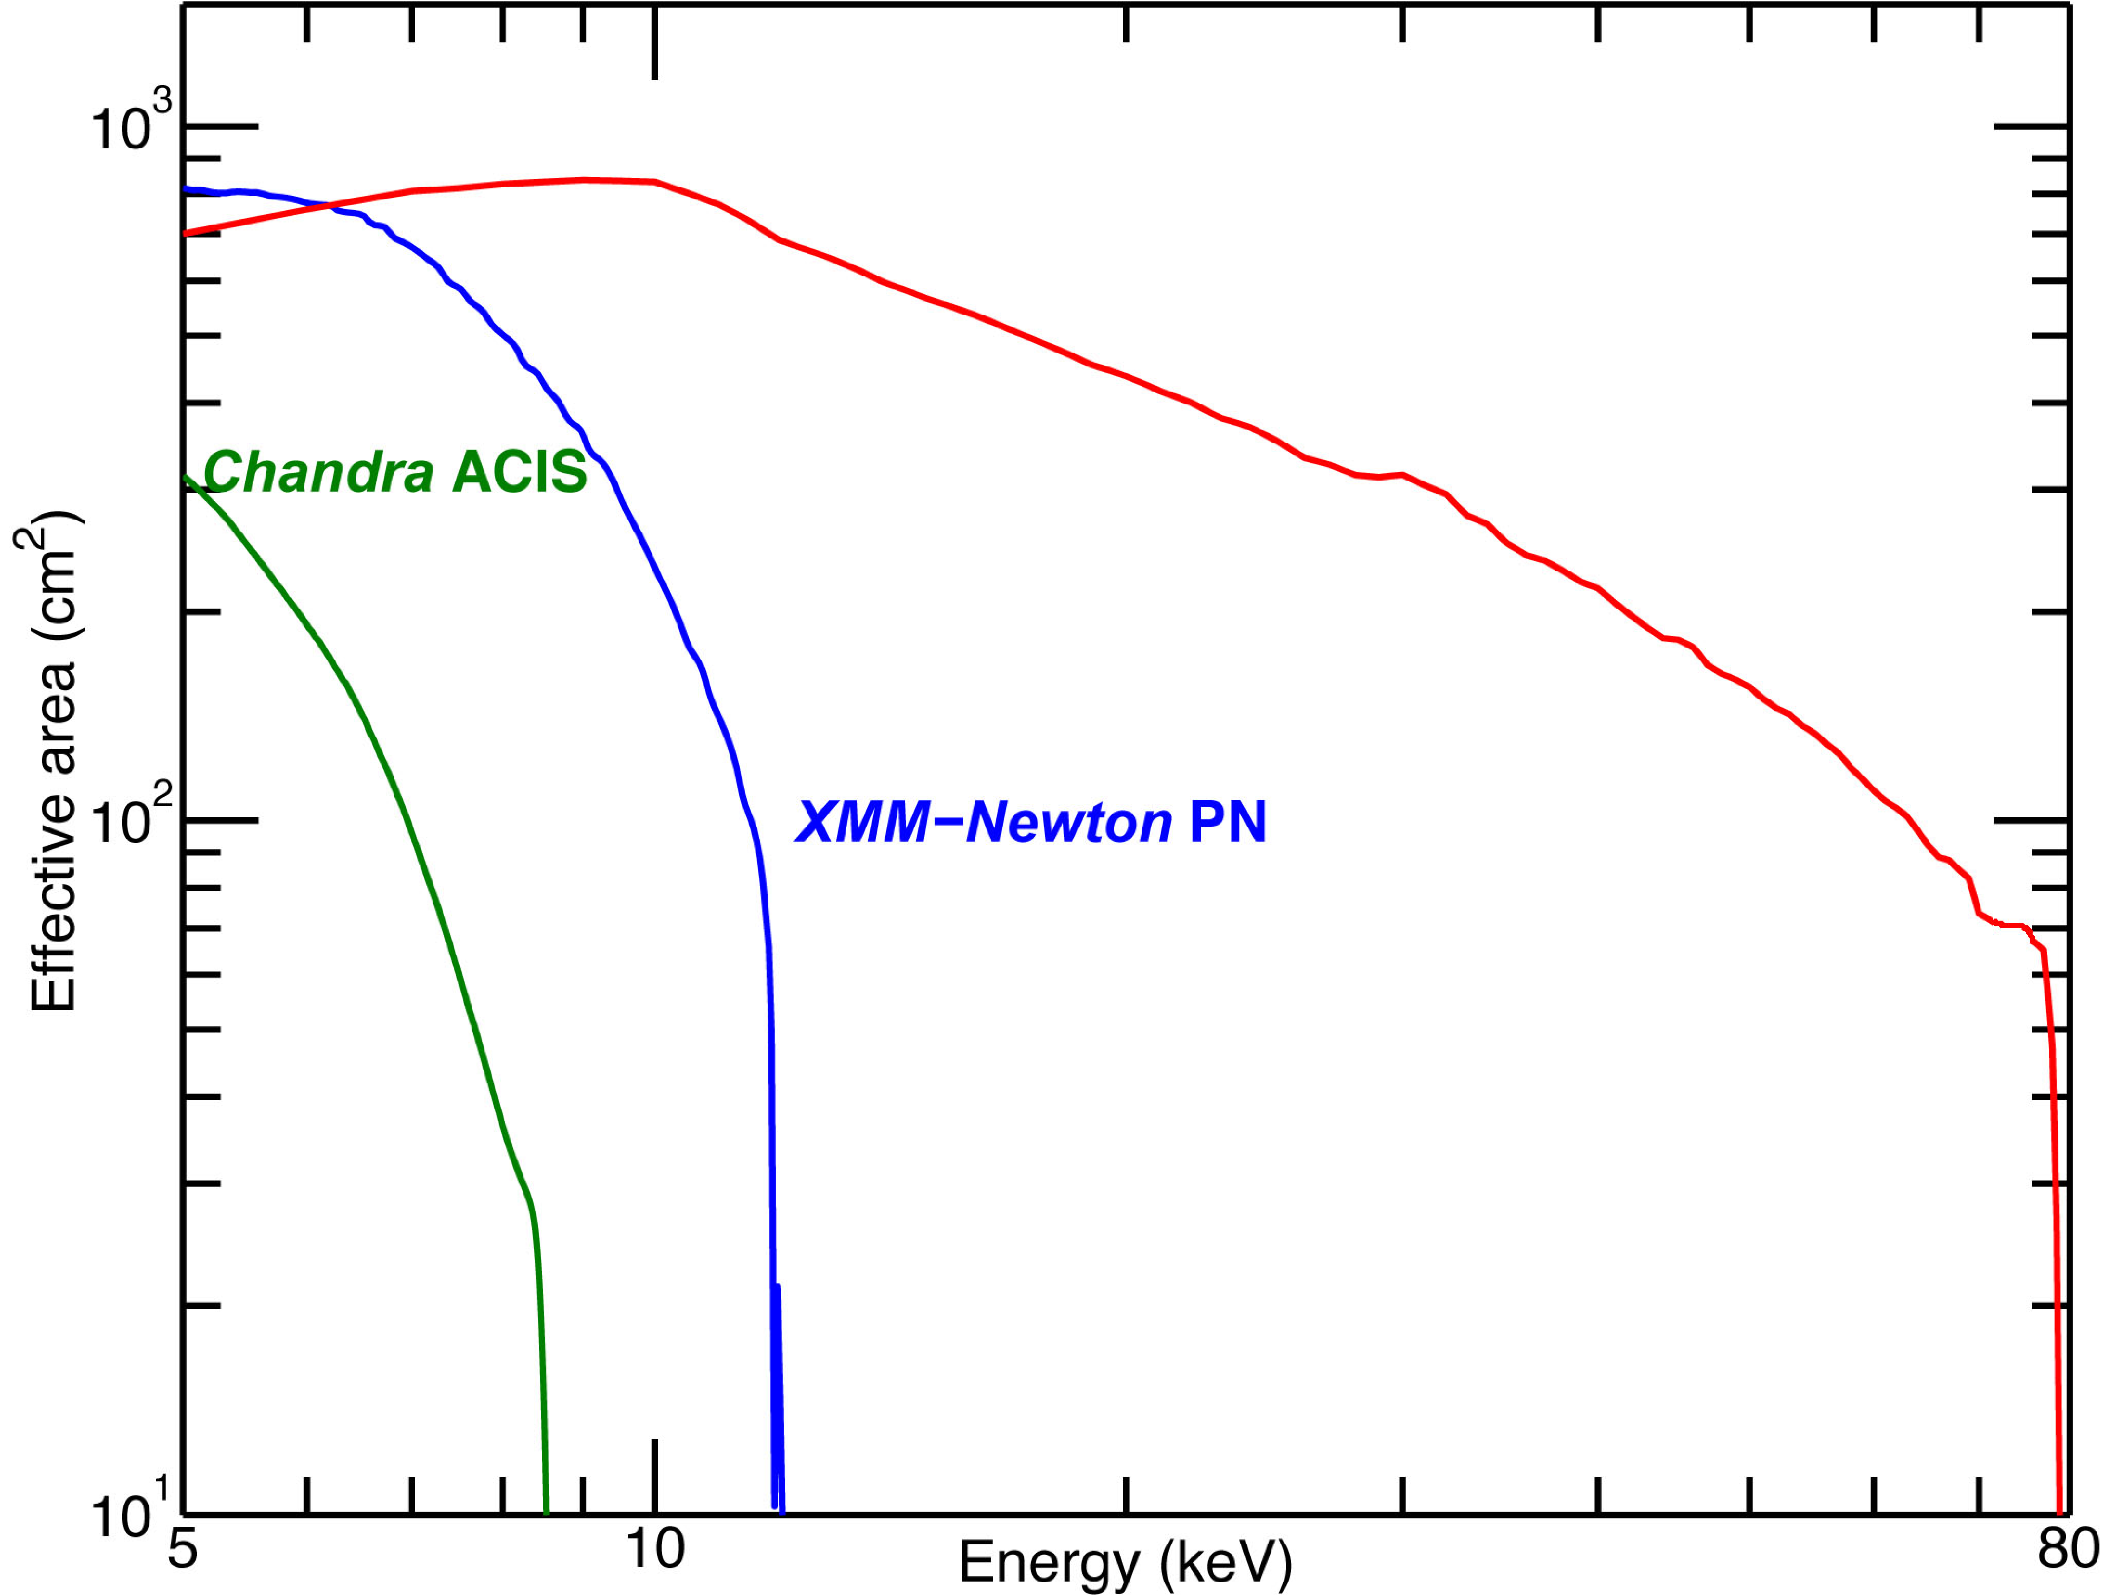
NuSTAR Sensitivity
Satellite | Sensitivity
INTEGRAL | ~0.5 mCrab (20-100 keV) with >Ms exposures
Swift (BAT) | ~0.8 mCrab (15-150 keV) with >Ms exposures
NuSTAR | ~0.8 μCrab (10-40 keV) in 1 Ms
NuSTAR
NuSTAR two-telescope total collecting area
Sensitivity comparison

Slide 6
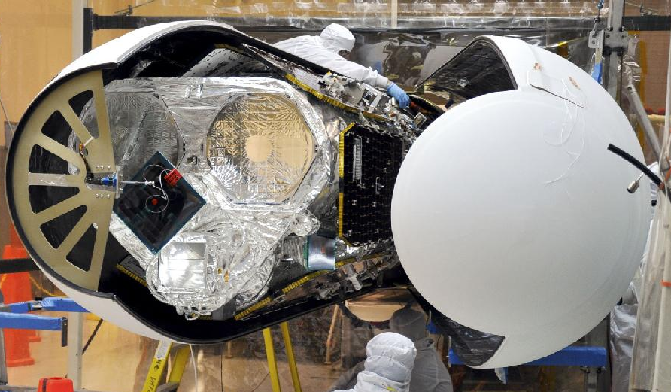
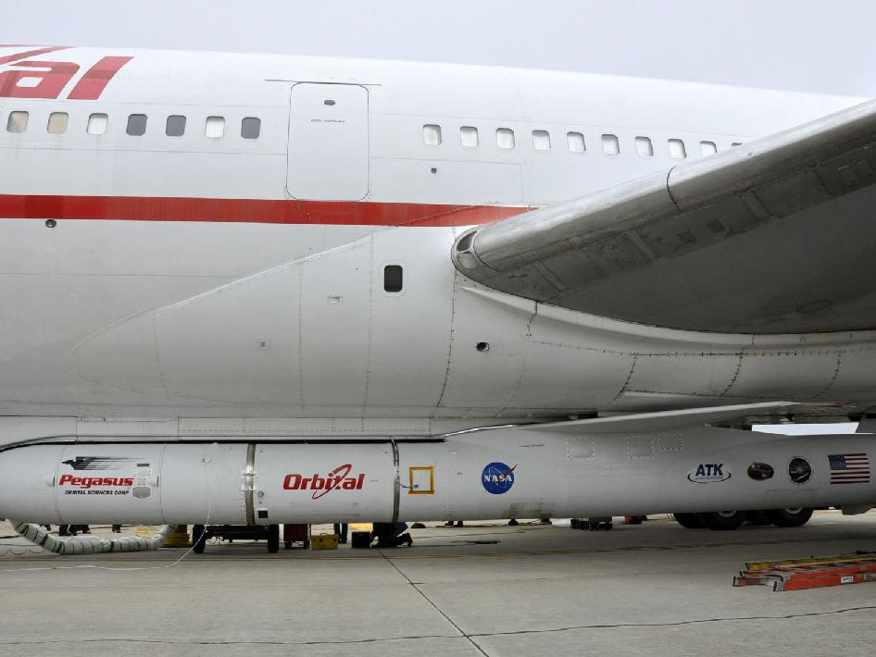
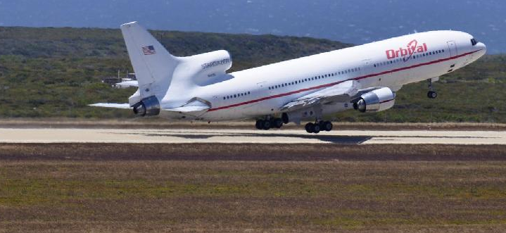
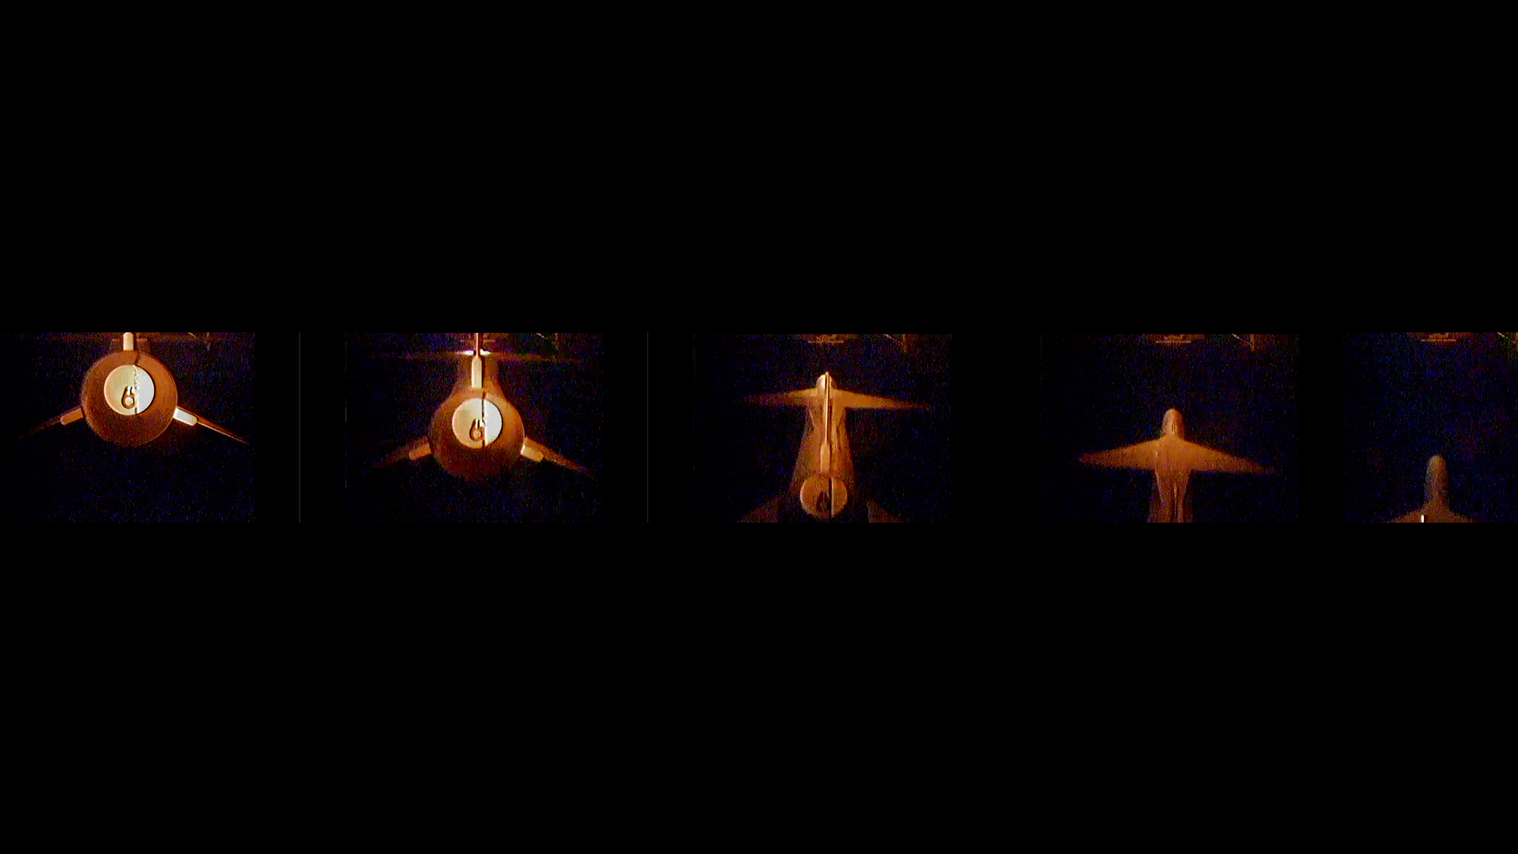
Launch June 13 2012
Reagan Test Site, Kwajalein Atoll

Slide 7
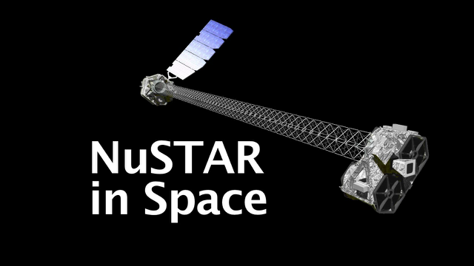
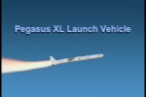
NuSTAR Launch June 13, 2012
NuSTAR DEPLOYS in Space
NuSTAR Pegasus Launch
~630 km orbit, 6 deg inclination
10 yr lifetime, no consumables

Slide 8
NuSTAR First Light: Cyg X-1

Slide 9

NuSTAR: PI F. Harrison (Caltech)
PI-led 2-yr mission with no Guest Observers’ program
All NuSTAR data public after verification phase

Slide 10
NuSTAR Calibration Results So Far:
Spectral resolution better than requirement
In-orbit mast motion consistent with predictions
Background stable, within pre-launch predictions
Low-E (5-20 keV) calibration agrees with Swift at <3% level
High-E calibration presently under study but no major surprises

Slide 11
NuSTAR Science Working Groups
Working Group | Chair
Heliophysics+Protostar Flares | David Smith
Galactic Plane Survey | Chuck Hailey
Supernovae, ToOs | Steve Boggs
Supernova Remnants, PWNe | Fiona Harrison
Galactic Binaries, HMXBs, LMXBs | John Tomsick
Magnetars, Rotation-Powered Pulsars | Vicky Kaspi
Ultraluminous X-ray Sources | Fiona Harrison
Extragalactic Surveys | Daniel Stern
Blazars and Radio Galaxies | Greg Madejski
AGN Physics | Giorgio Matt
Obscured AGN | Daniel Stern
Galaxy Clusters | Allan Hornstrup, Silvano Molendi
Starburst & Local Group Galaxies | Ann Hornschemeier
Calibration | Fiona Harrison

Slide 12
NuSTAR Science Working Groups
Working Group | Chair
Heliophysics+Protostar Flares | David Smith
Galactic Plane Survey | Chuck Hailey
Supernovae, ToOs | Steve Boggs
Supernova Remnants, PWNe | Fiona Harrison
Galactic Binaries, HMXBs, LMXBs | John Tomsick
Magnetars, Rotation-Powered Pulsars | Vicky Kaspi
Ultraluminous X-ray Sources | Fiona Harrison
Extragalactic Surveys | Daniel Stern
Blazars and Radio Galaxies | Greg Madejski
AGN Physics | Giorgio Matt
Obscured AGN | Daniel Stern
Galaxy Clusters | Allan Hornstrup, Silvano Molendi
Starburst & Local Group Galaxies | Ann Hornschemeier
Calibration | Fiona Harrison

Slide 13
NuSTAR Magnetar/Rotation-Powered Pulsars Observing Plan
Magnetar/RPP WG:
Chair: VMK; Members: H. An (McGill), E. Bellm (Caltech), D. Chakarabarty (MIT), F. Dufour (McGill), E. Gotthelf (Columbia), T. Kitaguchi (Caltech), C. Kouveliotou (NASA/MSFC), K. Mori (Columbia), M. Pivovaroff (LLNL), J. Vogel (LLNL), Collaborator A. Beloborodov (Columbia)
1.2 Ms allocation for WG over 2-yr baseline mission

Slide 14
Summary of A Targets: 1.2 Ms
Magnetar Target-of-Opportunity, 150 ks
Magnetar 1E 2259+586, 170 ks
Magnetar 1E 1048-5937, 400 ks
AE Aquarii, 80 ks
Rotation-Powered Pulsar Geminga, 260 ks
Binary RPP PSR J1023+0038, 100ks
Magnetar 1E 1841-045, 45 ks

Slide 15
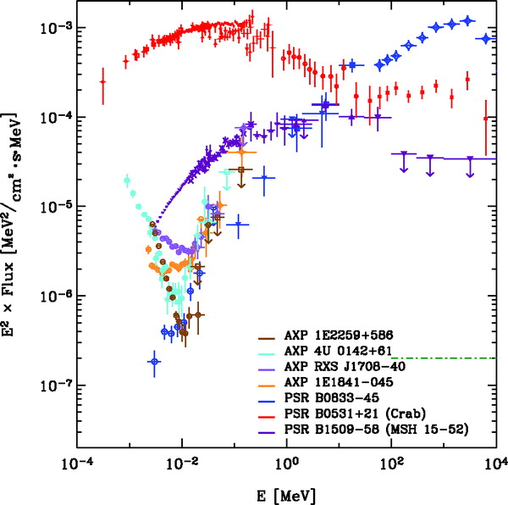
Magnetars’ Surprising Hard X-ray Turnover
Some are hardest known sources above 10 keV!
Some have more energy output in hard X-rays than in soft!
Unpredicted, not understood
Beloborodov (2012)
Kuiper et al. 2006

Slide 16
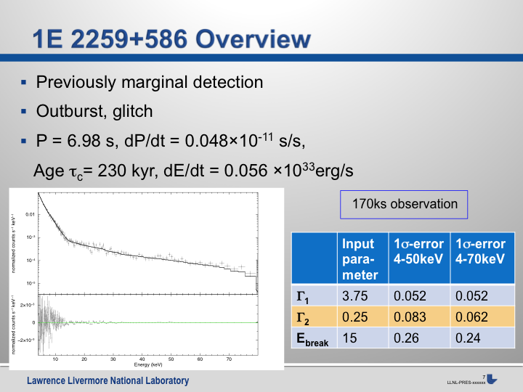
F. Dufour (McGill), J. Vogel (LLNL)

Slide 17
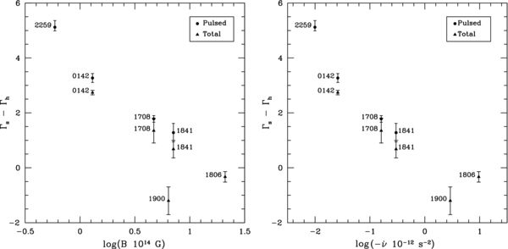
1E 2259+586: 170 ks
Previously hard X-ray detected but in pulsed emission only
Key data point in putative correlation between spectral turnover and spin-down rate
Kaspi & Boydstun 2010; Enoto et al. 2010

Slide 18
Summary of A Targets: 1.2 Ms
Magnetar Target-of-Opportunity, 150 ks
Magnetar 1E 2259+586, 170 ks
Magnetar 1E 1048-5937, 400 ks
AE Aquarii, 80 ks
Rotation-Powered Pulsar Geminga, 260 ks
Binary RPP PSR J1023+0038, 100ks
Magnetar 1E 1841-045, 45 ks
Also likely Kes 75/PSR J1846-0258
(absolute timing calibration)

Slide 19
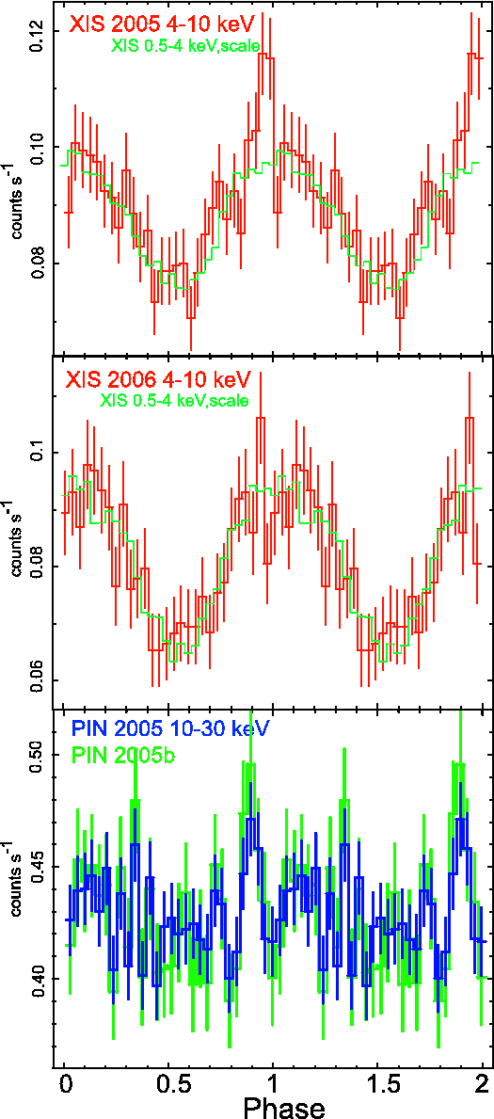
AE Aquarii: 80 ks
Intermediate polar with possible pulsar-like non-thermal X-ray emission as seen by Suzaku (Terada et al. 2008)
P=33s; possible peak seen in hard X-rays
Could be accelerating particles in magnetosphere as in radio pulsars?

Slide 20
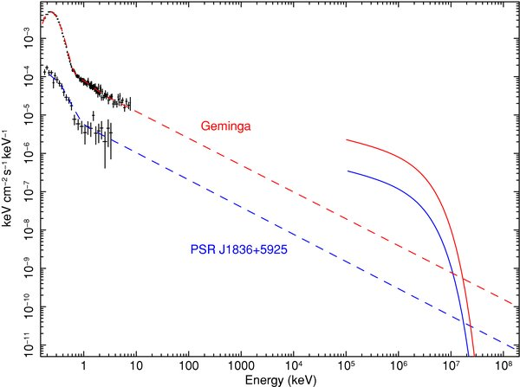
Geminga: 260 ks
Among brightest gamma-ray sources in the sky
Soft X-ray spectrum thermal
How spectrum turns up not well understood; true for many new Fermi pulsars
“gap” at hard X-rays: NuSTAR can fill it in
X-ray
Gamma Ray
Abdo et al. 2010

Slide 21
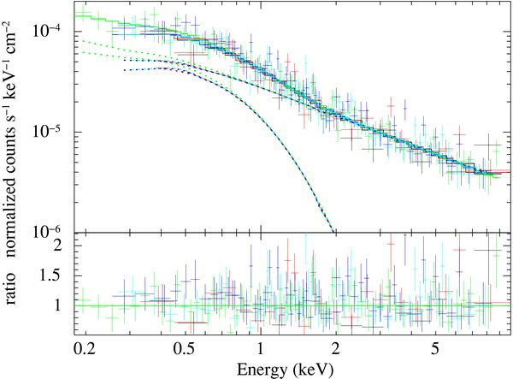
PSR J1023+0038: 100 ks
1.7 ms radio pulsar in 0.2-day orbit
Previous had accretion disk
qLMXB/RPP transition object – “missing link” (Archibald et al. 2009)
Hard PL X-rays modulated at orbital period
Template for understanding emission in qLMXBs; thought to be from hidden RPP in those systems
Archibald et al. 2010

Slide 22
NuSTAR SNR/PWN Observing Plan
SNR/PWN WG: Chair F. Harrison
1.5 Ms allocation for WG over 2-yr baseline mission
Pre-approved SN 1987A, Cas A, Crab, G21.5-0.9
Probably G1.9+0.3, SN1006 limb

Slide 23
NuSTAR Galactic Binaries Observing Plan
Galactic Binaries WG: Chair J. Tomsick (UCB)
0.5 Ms allocation for 2-yr baseline mission
Pre-approved Cen X-4, Her X-1, Cyg X-1, BH ToO
Vela X-1, 4U 1820-30, V404 Cyg, IGR J16318-4848, IGR J17544-2619, SAX J1808.4-3658, 1FGL J1018.6-5856

Slide 24
Summary
NuSTAR launched, appears to be in great shape!
Still working on calibration
Science observations just beginning
Exciting neutron star program planned
Magnetars, rotation-powered pulsars, binaries, and more
Stay tuned!

Slide 25
In-flight Spectral Resolution
In-flight radioactive source calibration – FPMB at high energy
High-energy resolution - 1 keV FWHM including all science grades
(0.92 keV for FPMB, 1.0 keV for FPMA – Requirement: < 1.6 keV)
Low-energy resolution: 0.4 keV FWHM@6 keV

Slide 26
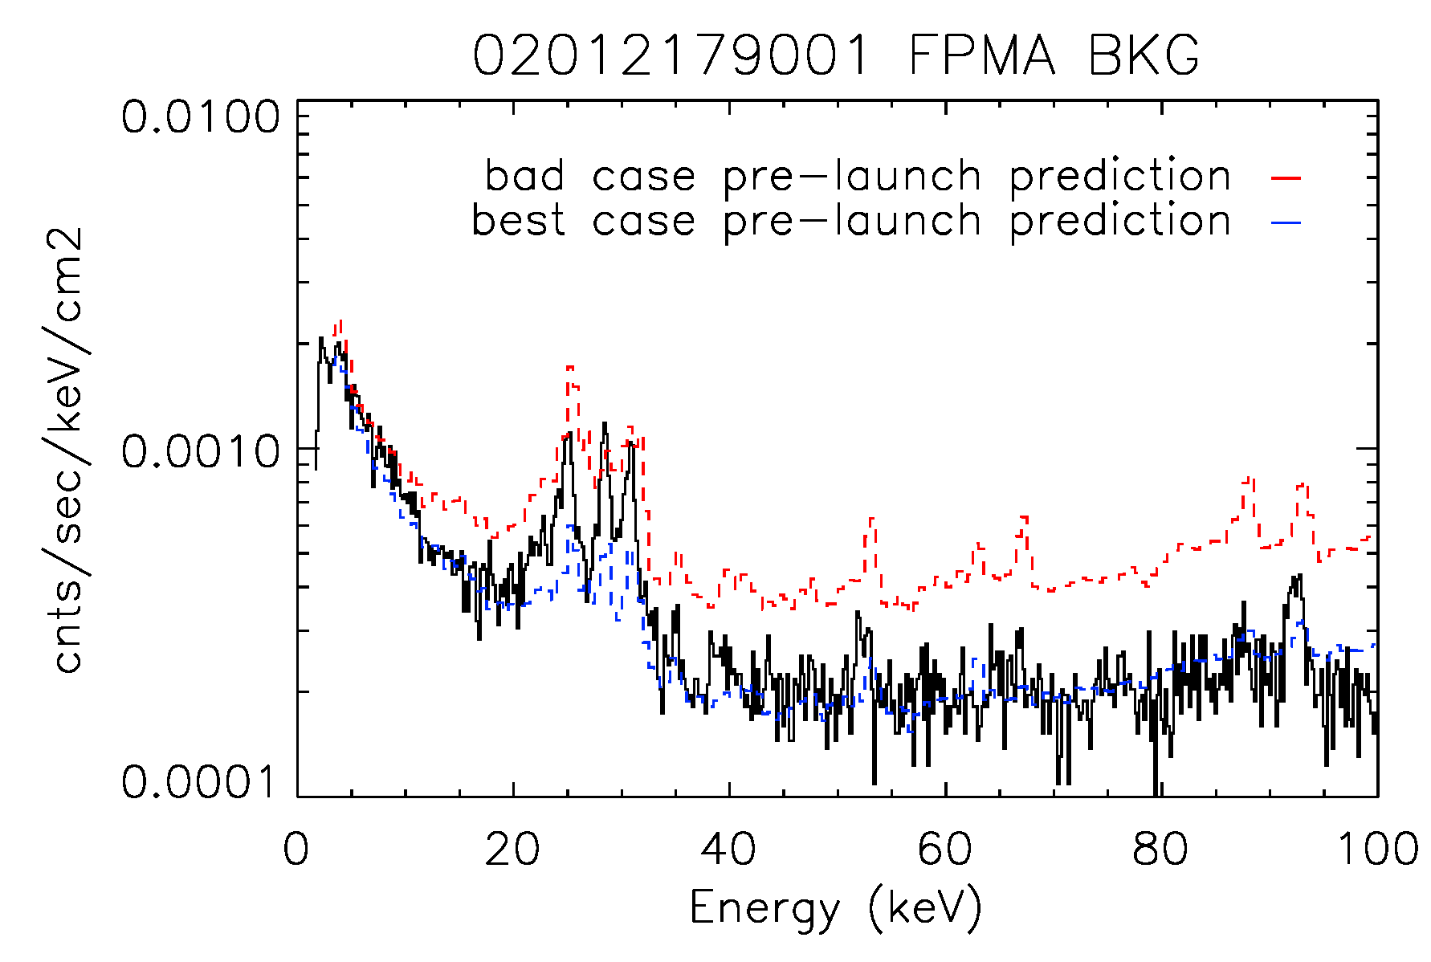
Measured Background
L4 FPE requirement
Measured background (black) vs. NuSIM models (worst case NuSIM not shown) for FPMA

Slide 27
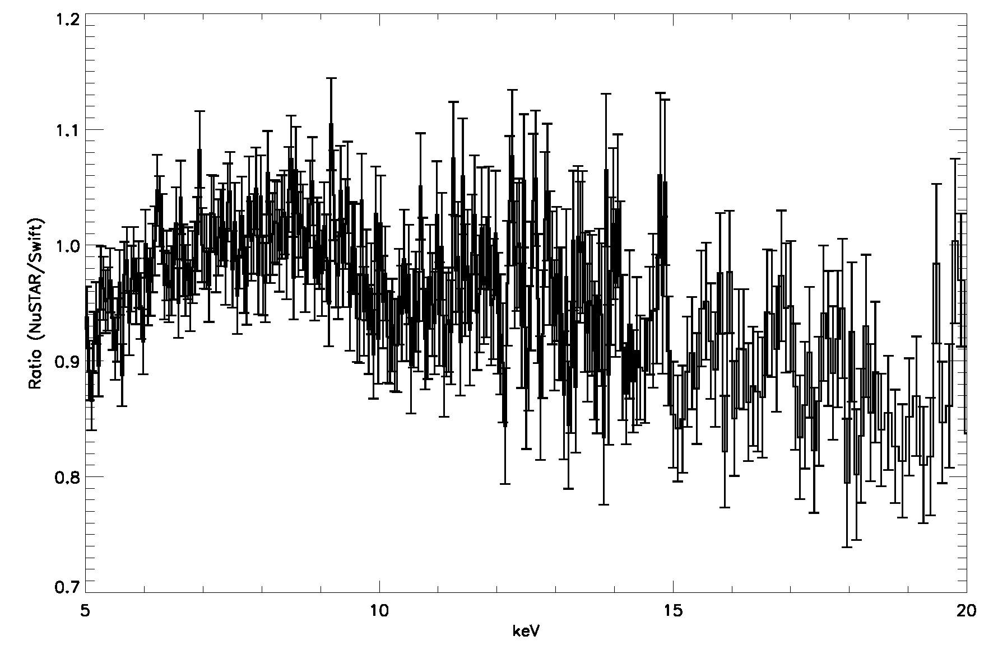
Comparison to Swift
Ratio of NuSTAR/Swift flux using Swift best-fit model
Swift 5-10 keV measured flux: 4.28 e⁻¹¹ ergs/ s/cm²
4.108e-11 - 4.517e-11) (95% confidence)
NuSTAR 5-10 keV measured flux: 4.4 e⁻¹¹ ergs /s/cm²
No ”calibration factor” applied – uses best NuSTAR ground calibration – agree to better than 2.5%(!)

Slide 28
Target | Comment | Approx integration
Cygnus X-1 | First light | 20 ksec
3C 273 | Optical axis determination/alignment, cross-calibration (Chandra, XMM, Suzaku, INTEGRAL) | 350 ksec
GRS1915+105 | Instrument Saa alignment | 30 ksec
1E1740.7-2942 | Instrument Saa alignment | 30 ksec
LMC X-4 | Instrument Saa alignment | 30 ksec
SMC X-1 | Instrument Saa alignment | 30 ksec
Mkn 421 | Instrument Saa alignment | 30 ksec
Vela X-1 | Instrument Saa alignment | 30 ksec
PKS 2155-304 | Instrument Saa alignment | 30 ksec
GS0834-430 | Instrument Saa alignment | 30 ksec
MCG 5-23-16 | Instrument Saa alignment | 30 ksec
Sgr A* | Science (joint with Chandra) | 200 ksec
Crab | Optical axis calibration | 60 ksec
NGC 1365 | Joint with XMM | 250 ksec
G21.9 PWN | Response Calibration | 350 ksec

Slide 29
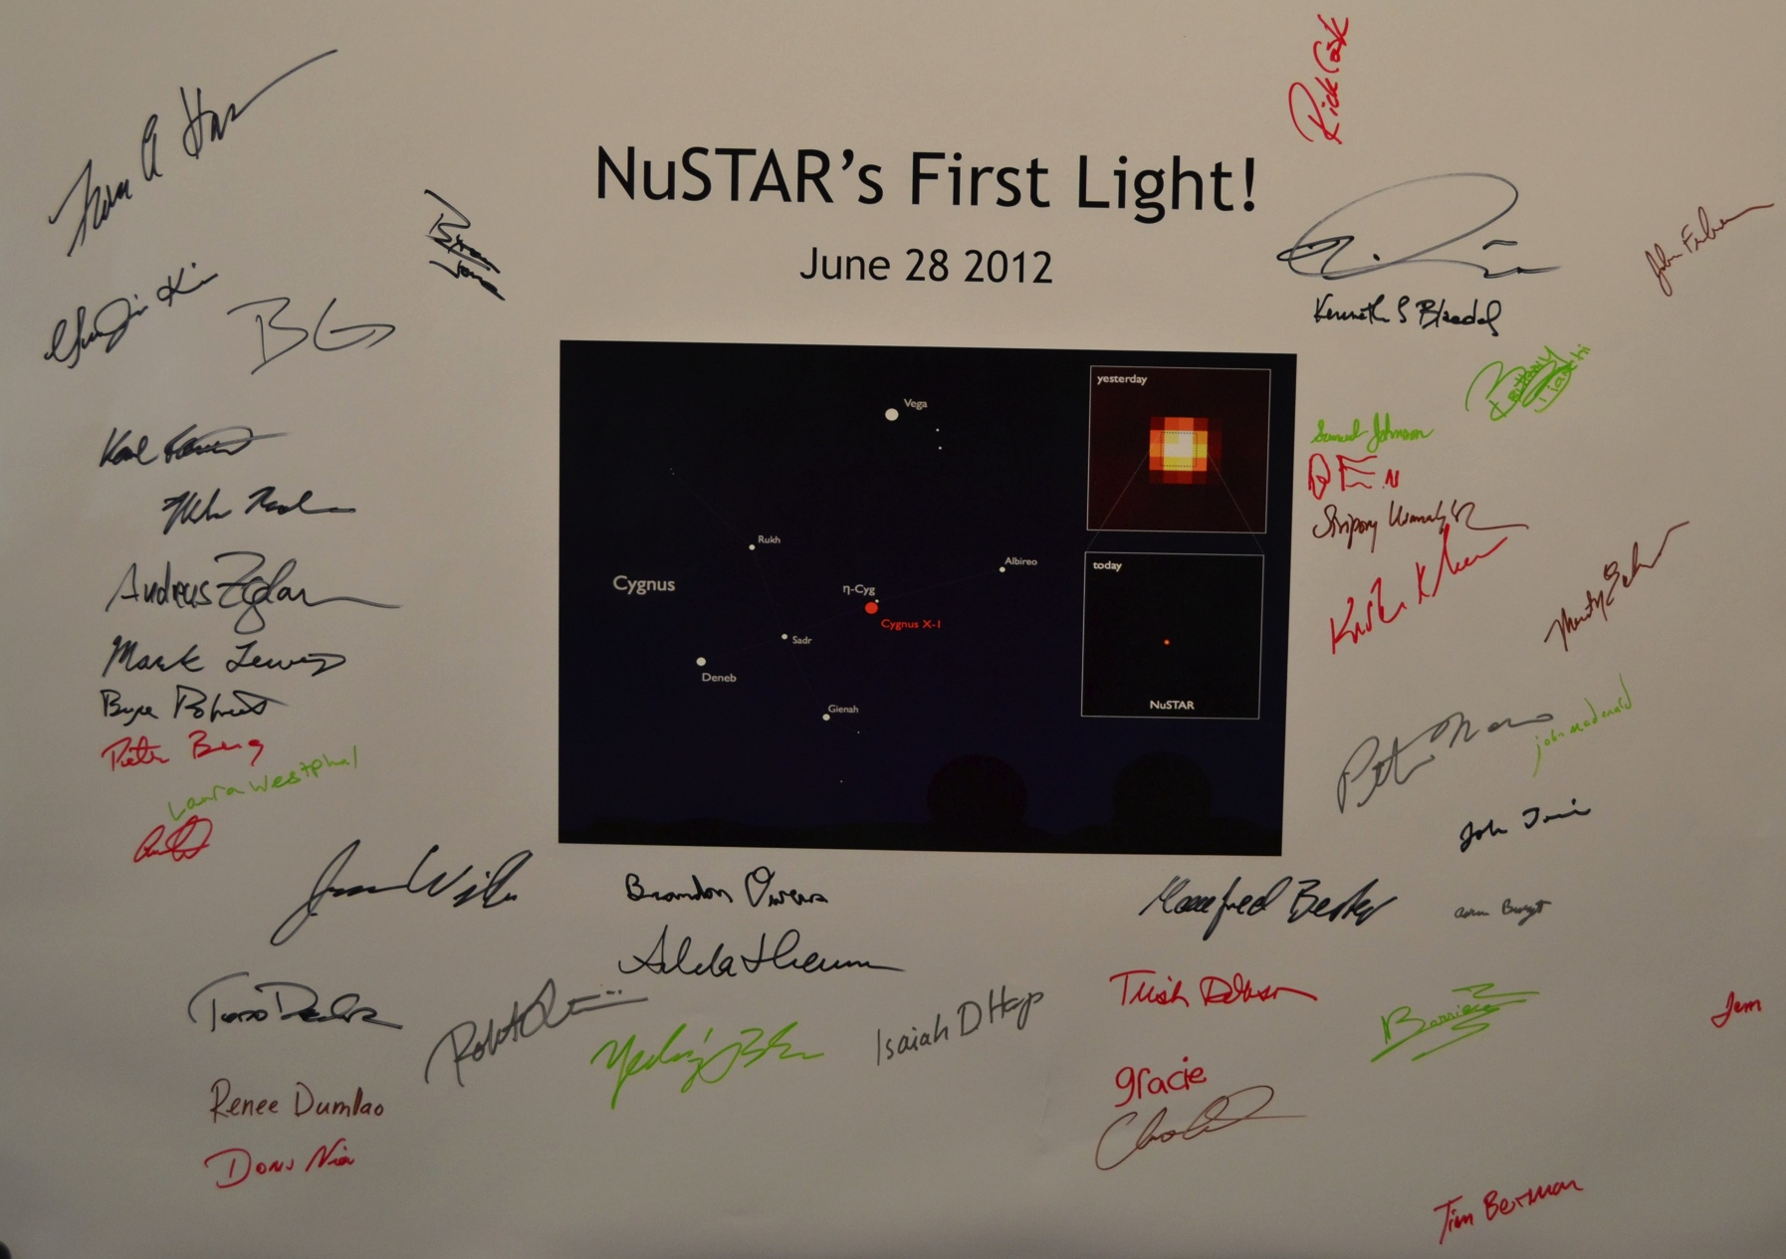
Commissioning Team PI Fiona Harrison, Caltech
Hongjun An (McGill)
Matteo Bachetti (IRAP)
Eric Bellm (CIT)
Mislav Bolokovik (CIT)
Rick Cook (CIT)
Bill Craig (UCB/LLNL)
Andrew Davis (CIT)
Karl Forster (CIT)
Felix Fuerst (CIT)
Brian Grefenstette (CIT)
Ting-Ni Lu (NTHU)
Kristin Madsen (CIT)
Peter Mao (CIT)
Hiromasa Miyasaka (CIT)
Matteo Perri (ASDC)
Simonetta Puccetti (ASDC)
Vikram Rana (CIT)
Dominic Walton (CIT)
Niels Joern Westergaard (DTU)
Andreas Zoglauer (UCB)

