Slide 1
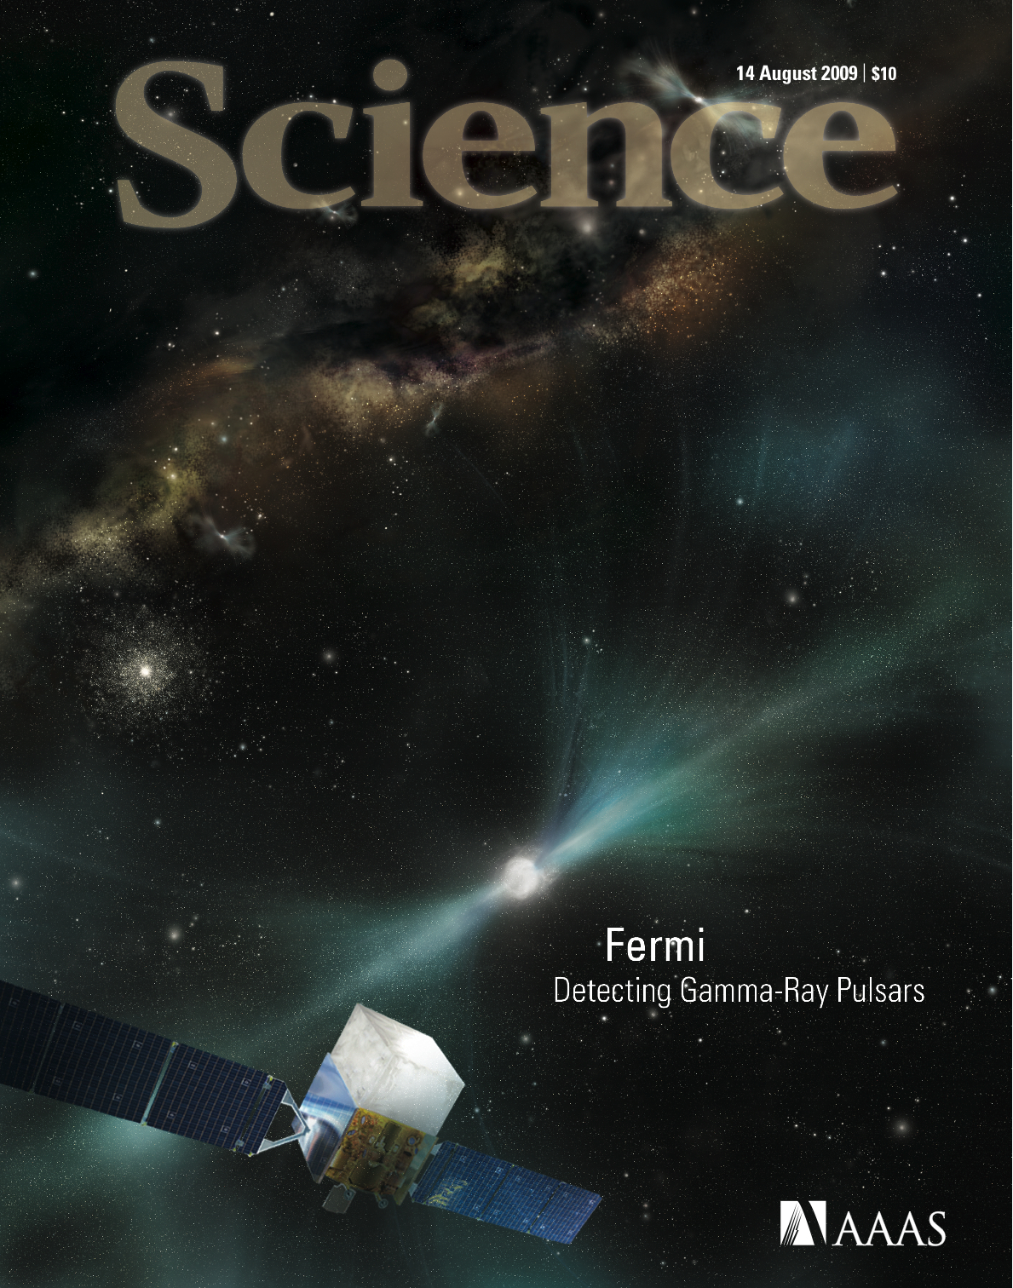

Pulsars in
$γ$ Rays:
What Fermi Is Teaching Us
Matthew Kerr
kerrm@stanford.edu
Stanford University / KIPAC

Slide 2
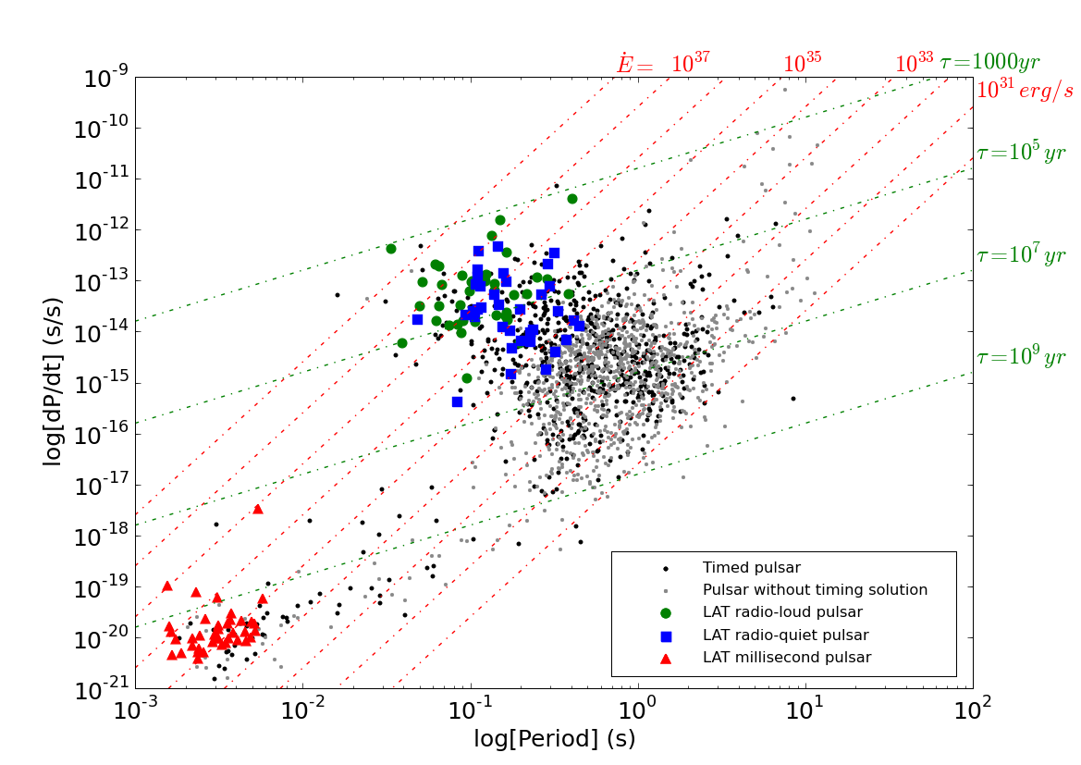
Why Gamma Rays (I): 117+ Pulsars!
2PC PRELIMINARY

Slide 3
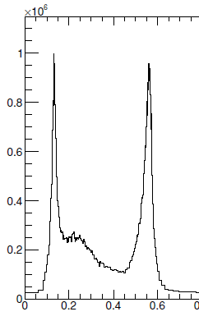
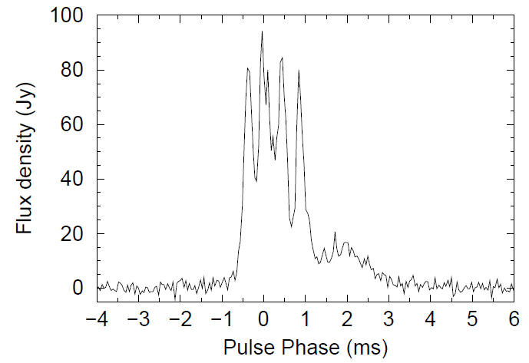
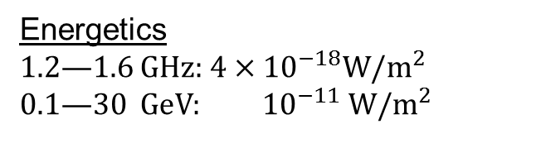
Why Gamma Rays? (II)
Kramer, Johnston, van Straten, 2006
Abdo+, 2010 “Vela 2”
20 cm
Micro-structure: “plasma weather”
Energetics
1.2—1.6 GHz: $4×{10}^{−18}W/m^{2}$
0.1—30 GeV: ${10}^{−11} W/m^{2}$
Gamma efficiencies can be >1%: an appreciable volume of magnetosphere must be involved in acceleration/emission.

Slide 4
Why Gamma Rays? (III)
Gamma rays are produced incoherently by ultrarelativistic particles:
Particles (probably) have small pitch angle distribution…
… so gamma rays should be beamed along field lines.
Propagation effects are negligible (in the outer magnetosphere).
Nobody puts gamma rays in the corner.
So gamma rays can directly track structure of magnetic field!
Or, with a magnetic field model, gamma rays can tell us where they come from.

Slide 5
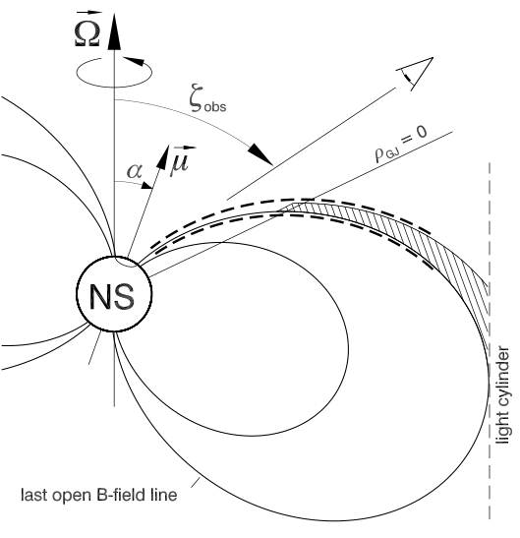
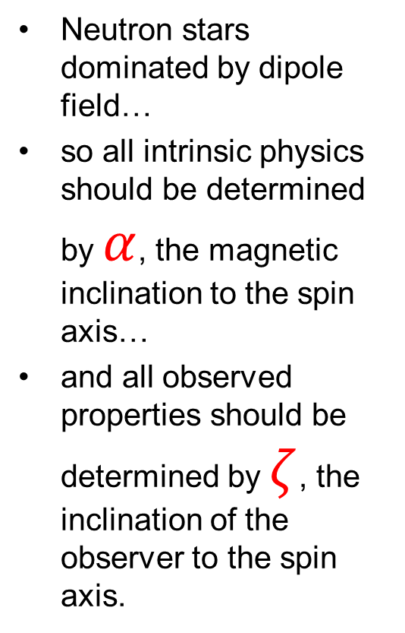
Basic Geometry
Neutron stars dominated by dipole field…
so all intrinsic physics should be determined by $α$, the magnetic inclination to the spin axis…
and all observed properties should be determined by $ζ$, the inclination of the observer to the spin axis.

Slide 6
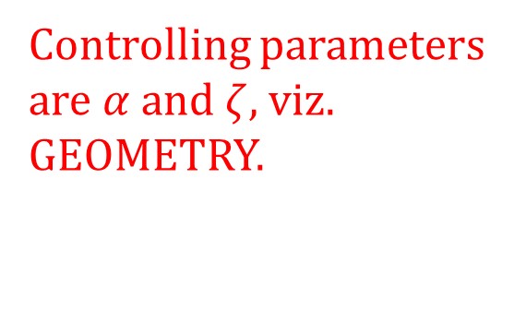
A closer look at “Geometry”: Emission Models
Polar Cap (PC)
Arons, ApJ 1979
Harding, ApJ 1982
Outer Gap (OG)
Cheng, Ho, Ruderman, ApJ 1986
Romani ApJ 1996
Slot Gap (SG) / Two-pole Caustic (TPC)
Arons, ApJ 1983
Muslimov & Harding, ApJ 2004
Dyks & Rudak, ApJ 2003
Separatrix Layer (SL)
Bai & Spitkovsky 2010
radio emission cone
γ-ray emission fan beam
Controlling parameters are $α$ and $ζ$, viz. GEOMETRY.

Slide 7
Gamma rays
(mostly)
come from the outer magnetosphere.

Slide 8
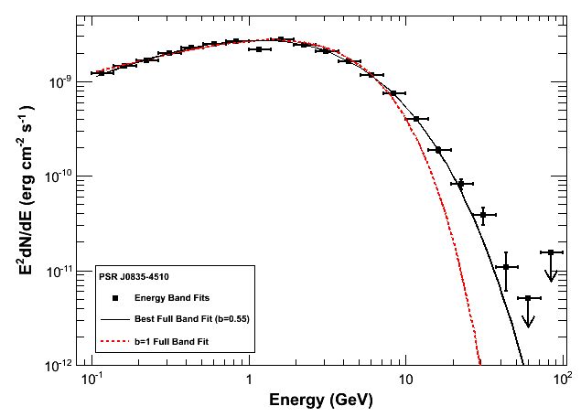

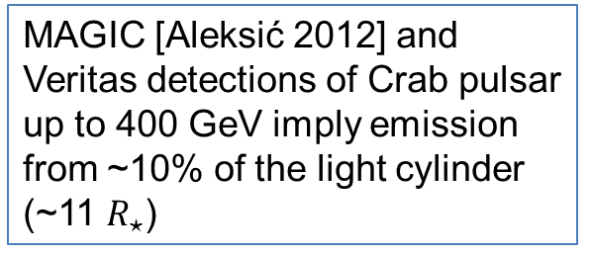
Evidence: Spectral Cutoffs
Strong magnetic fields can attenuate gamma rays through pair production. The opacity depends exponentially on energy, so the gamma-ray spectrum is “super-exponentially” cutoff above the critical energy [Baring, 2004]:
Vela
2PC PRELIMINARY
40 GeV $→r>\sim 5R_{⋆}$
MAGIC [Aleksić 2012] and Veritas detections of Crab pulsar up to 400 GeV imply emission from ~10% of the light cylinder (~11 $R_{⋆}$)

Slide 9
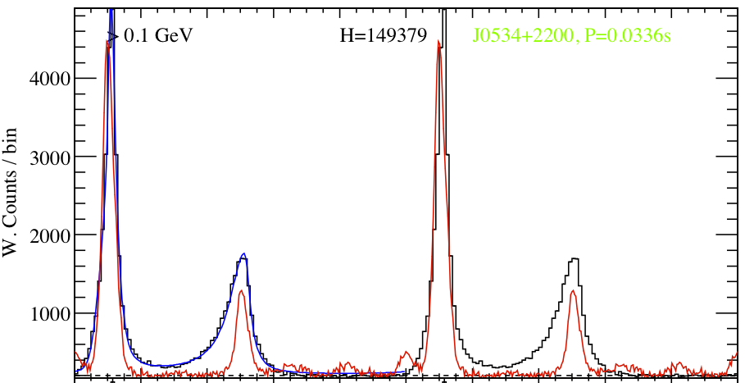
Evidence: Caustics
Cheng, Ho, Ruderman 1986: for radiation emitted at a fraction of the light cylinder, emission piles up in phase due to time-of-flight + aberration offset.
General property of outer magnetospheric emission, regardless of exact shape of magnetic field!
2PC PRELIMINARY

Slide 10
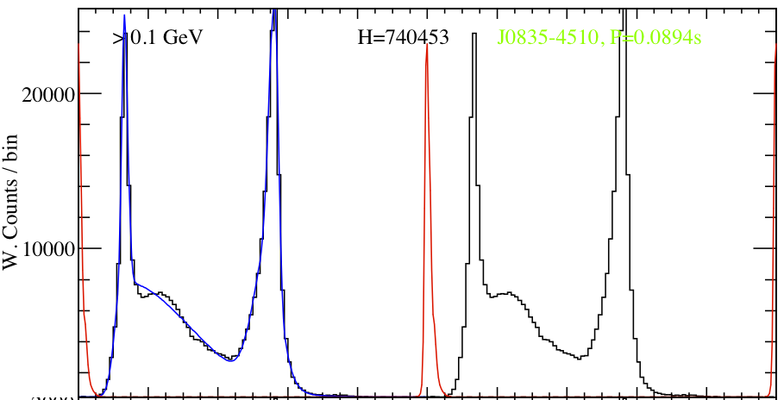
Evidence: Caustics
Cheng, Ho, Ruderman 1986: for radiation emitted at a fraction of the light cylinder, emission piles up in phase due to time-of-flight + aberration offset.
General property of outer magnetospheric emission, regardless of exact shape of magnetic field!
2PC PRELIMINARY

Slide 11
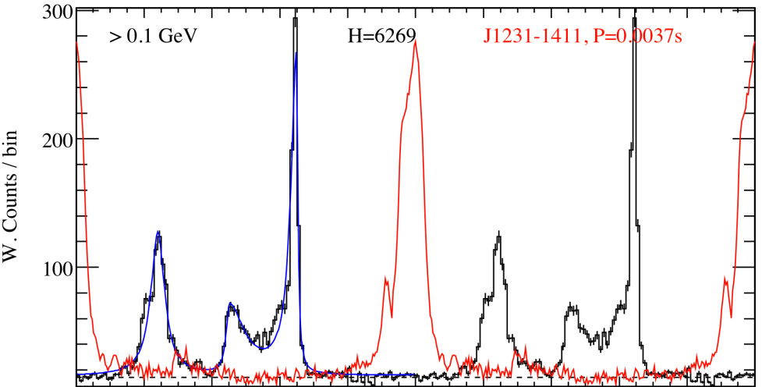
Evidence: Caustics
Cheng, Ho, Ruderman 1986: for radiation emitted at a fraction of the light cylinder, emission piles up in phase due to time-of-flight + aberration offset.
General property of outer magnetospheric emission, regardless of exact shape of magnetic field!
2PC PRELIMINARY

Slide 12
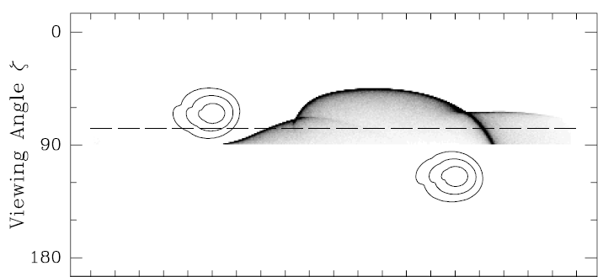

Evidence: Multiwavelength Light Curves
Geometric emission models (particularly Outer Gap: CHR86, Romani & Yadigaroglu 1994) predict an anticorrelation between the delay between radio (if observed) and gamma emission ($δ)$ and the separation of the gamma-ray peaks ($Δ$).
Romani & Yadigaroglu 1994

Slide 13
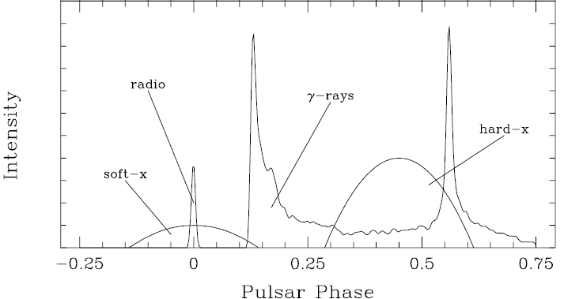

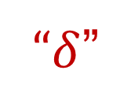
Evidence: Multiwavelength Light Curves
Geometric emission models (particularly Outer Gap: CHR86, Romani & Yadigaroglu 1994) predict an anticorrelation between the delay between radio (if observed) and gamma emission ($δ)$ and the separation of the gamma-ray peaks ($Δ$).
“$Δ$”
“$δ$”
Romani & Yadigaroglu 1994

Slide 14
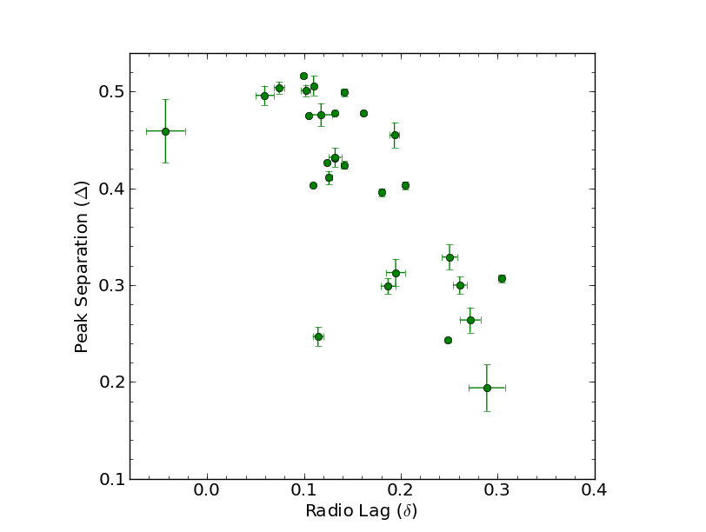
“delta” vs. “Delta”
Young Pulsars
2PC PRELIMINARY

Slide 15
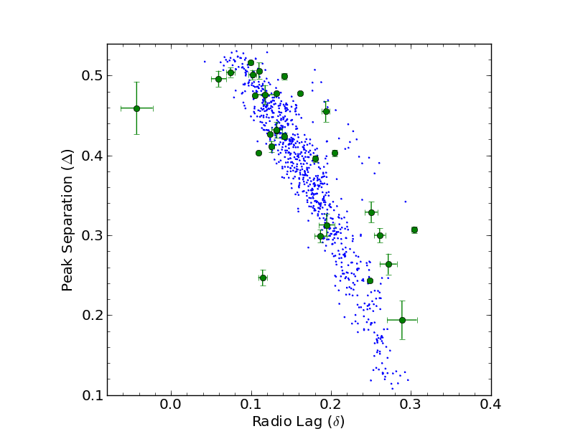
“delta” vs. “Delta”
Points from Watters et al., 2009
Young Pulsars
2PC PRELIMINARY

Slide 16
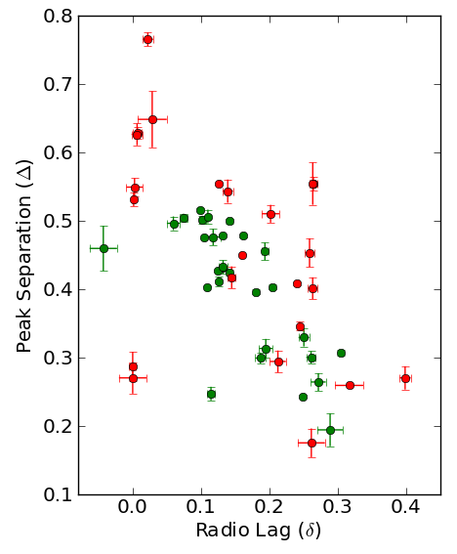
With MSPs?
One sub-group (J0030+0451 is prototype) resembles “young” pulsars.
Others are complicated:
Triples (e.g. 1231-1411)
Aligned (B1937+21, B1957+20, J1823-3001A)
See Espinoza et al. (in prep)!
Emission from multiple poles?
Bias in selecting fiducial phase…
Whole process further complicated by profile evolution…
2PC PRELIMINARY
Young Pulsars
MSPs

Slide 17
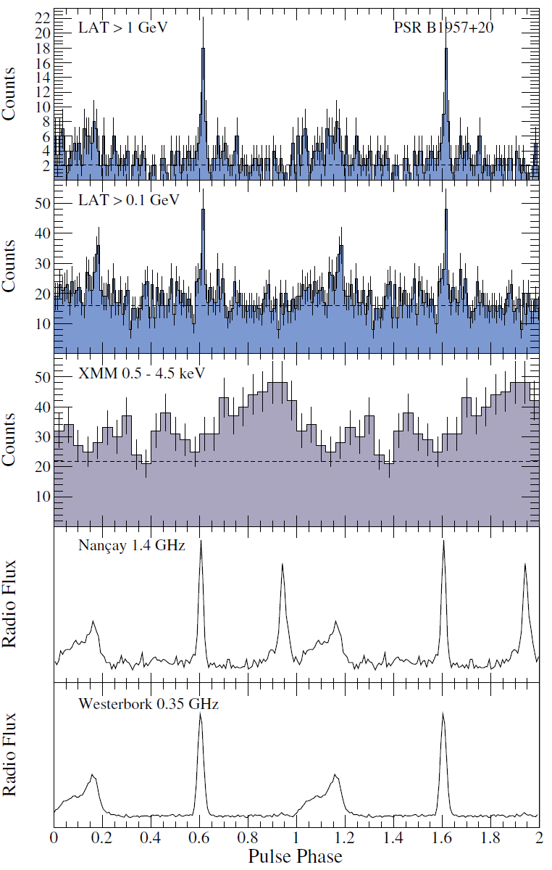
With MSPs?
Guillemot+, 2012

Slide 18
With MSPs?
One sub-group (J0030+0451 is prototype) resembles “young” pulsars.
Others are complicated:
Triples (e.g. 1231-1411)
Aligned (B1937+21, B1957+20, J1823-3001A)
See Espinoza et al. (in prep)!
Emission from multiple poles?
Bias in selecting fiducial phase…
Whole process further complicated by profile evolution…
2PC PRELIMINARY
Young Pulsars
MSPs

Slide 19
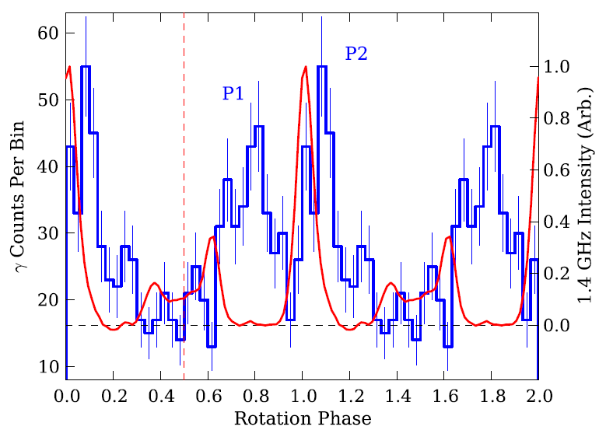

With MSPs?
“$δ$”
vs.
Kerr+, 2012

Slide 20
With MSPs?
One sub-group (J0030+0451 is prototype) resembles “young” pulsars.
Others are complicated:
Triples (e.g. 1231-1411)
Aligned (B1937+21, B1957+20, J1823-3021A)
See Espinoza et al. (in prep)!
Emission from multiple poles?
Bias in selecting fiducial phase…
Whole process further complicated by profile evolution…
2PC PRELIMINARY
Young Pulsars
MSPs

Slide 21
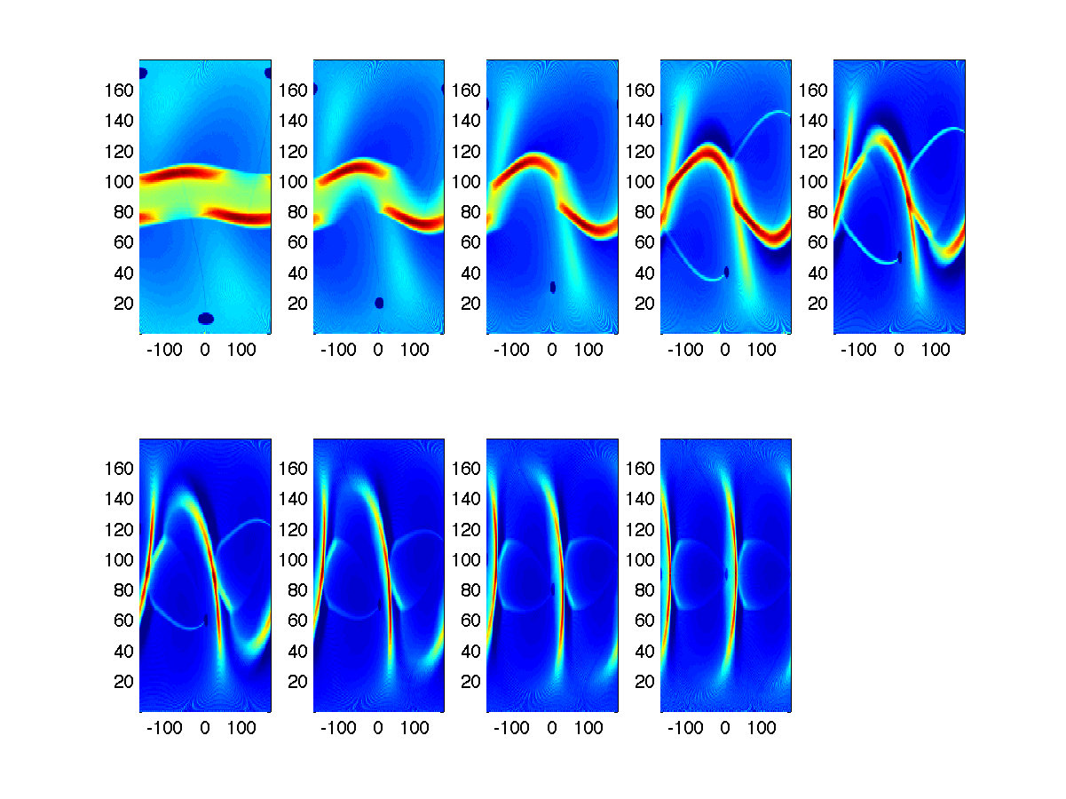

Evidence: Little DC Emission
Models with low-altitude emission (e.g. two-pole caustic, slot gap) tend to predict emission throughout the pulse phase, viz. a “DC” component.
Slot Gap $α=60°$ courtesy Alice Harding.

Slide 22
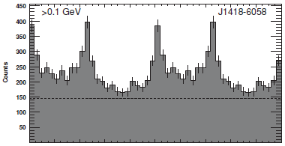
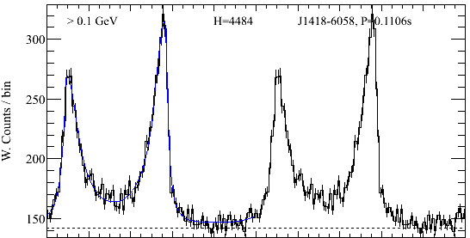
Evidence: Little DC Emission
1PC
Most pulsars show a minimum consistent with the background.
Some exceptions:
J1836-5825, J2021+4026
Confirmed spectroscopically.
2PC light curves use a photon weighting technique that provides spectral estimate of the absolute background!
2PC PRELIMINARY

Slide 23
Most gamma ray spectra are consistent with ~monoenergetic curvature radiation.

Slide 24


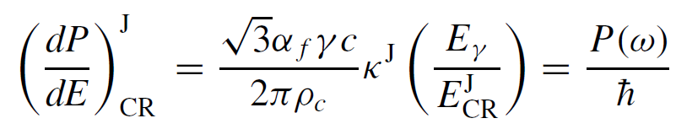
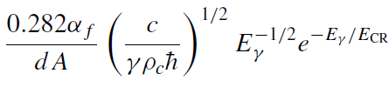
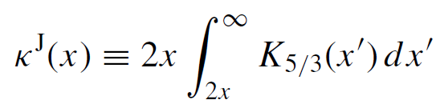



Curvature Radiation
Curvature radiation is simply synchrotron radiation where the particle acceleration is not due to gyration around a field line but the gradual trajectory change induced as it bends.
Acceleration driven by $E||B$; limited by losses to curvature radiation; sets particle $γ$ factor, which sets ~maximum (cutoff) energy of the spectrum – note it is independent of particle energy, magnetic field strength!
Predicted spectrum: precisely synchrotron spectrum with this energy as critical frequency.
Venter & De Jager, 2010
$$E≪E_{CR}$$
$$E≫E_{CR}$$

Slide 25
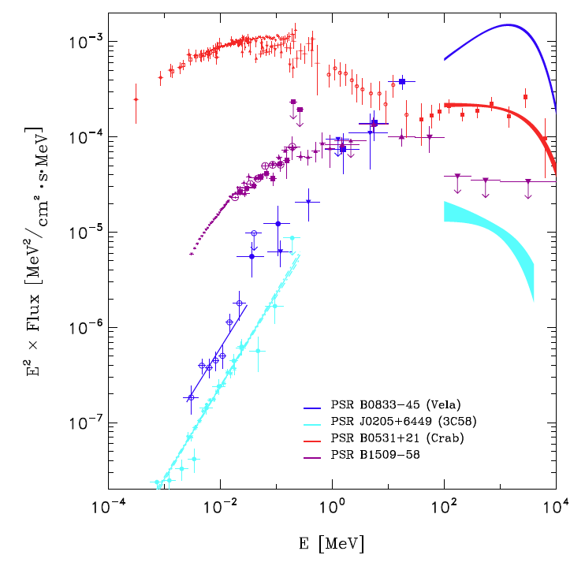

LAT Pulsar Spectra
The spectra of nearly every LAT pulsar is fit reasonably well by a power-law times an exponential cutoff!
Bright pulsars (viz. those with lots of statistics; primarily non-MSPs) prefer slightly harder tails, encapsulated by $b<1$ in the general model $\frac{dN}{dE}=kE^{−Γ}exp {\left(\frac{E}{E_{CR}}\right)}^{b}$.
Vela
2PC PRELIMINARY

Slide 26
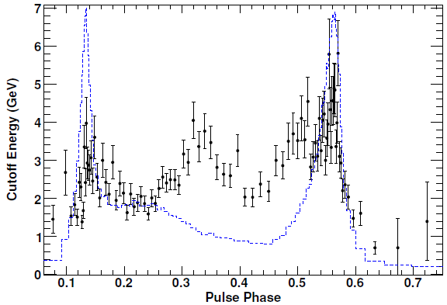

Significance of b < 1?
b=1 case is only an approximation to synchrotron spectrum anyway, and valid only for $E≫E_{CR}$, which doesn’t hold.
Phase-averaged spectrum (and even a narrow slice of light curve) receives contributions from many field line sections, each with different curvature radii and/or accelerating fields.
Abdo+ 2010 “Vela 2”

Slide 27
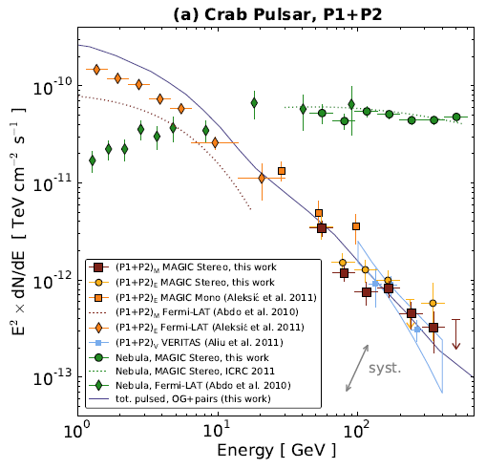
Exception: Crab
Credit: Kuiper+ (in prep.)
Aleksić+, 2012, A&A

Slide 28
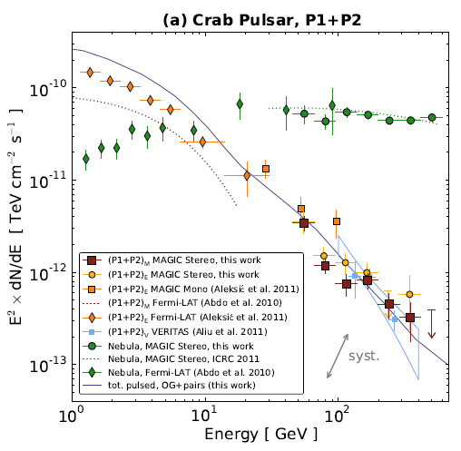
Exception: Crab
Crab is a young, powerful, hot pulsar with a strong magnetic field – should be able to make many pairs, soft photon fields. So, likely synchrotron self-Compton. Unclear how much of spectrum due to curvature radiation.
See e.g. Aleksić 2011, Lyutikov+ 2012, Du+ 2012.
Credit: Kuiper+ (in prep.)
Aleksić+, 2012, A&A

Slide 29
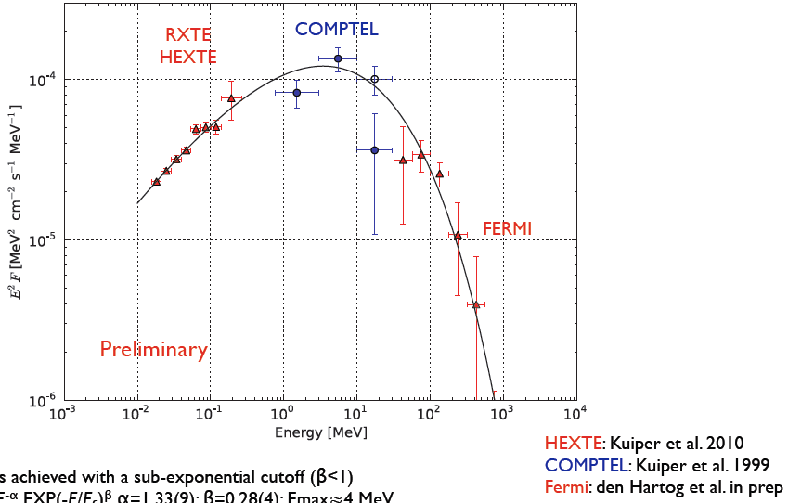
Exception: PSR B1509-58

Slide 30

Exception: Aligned MSPs
Alignment suggests $γ$ and radio come from same set of field lines.
Presence of giant radio pulses + overall difficulty in (the author) imagining how to get coherent plasma emission while accelerating particles & emitting gamma rays suggests a theory of emission should be time-dependent/stochastic.

Slide 31
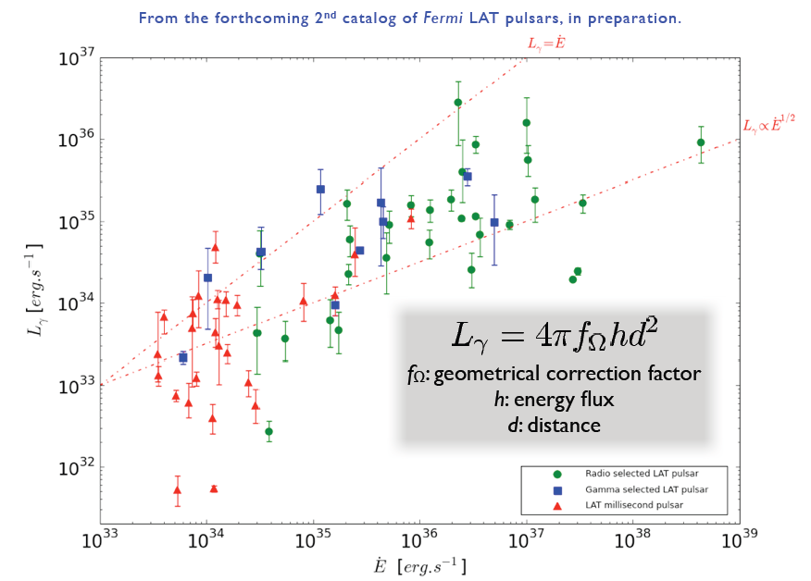
Other Trends (I)
2PC PRELIMINARY

Slide 32
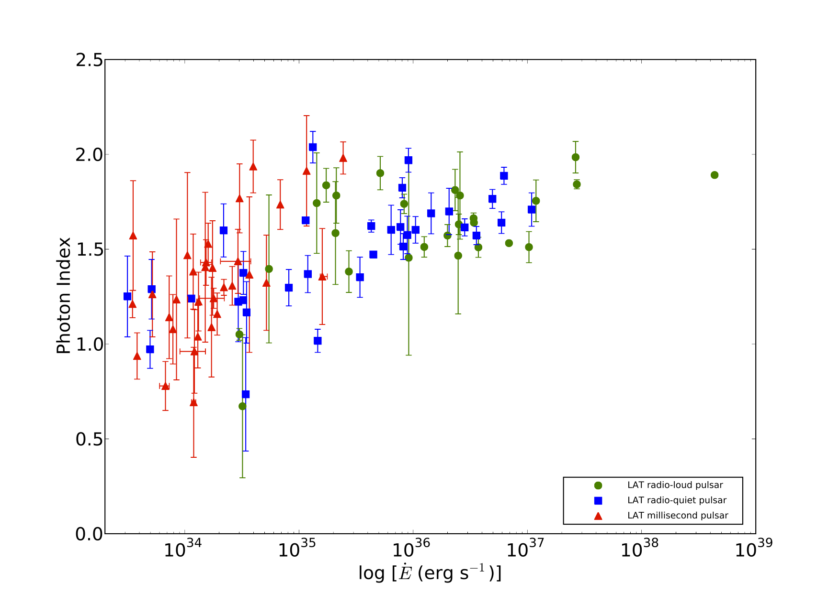
Other Trends (II)
2PC PRELIMINARY

Slide 33
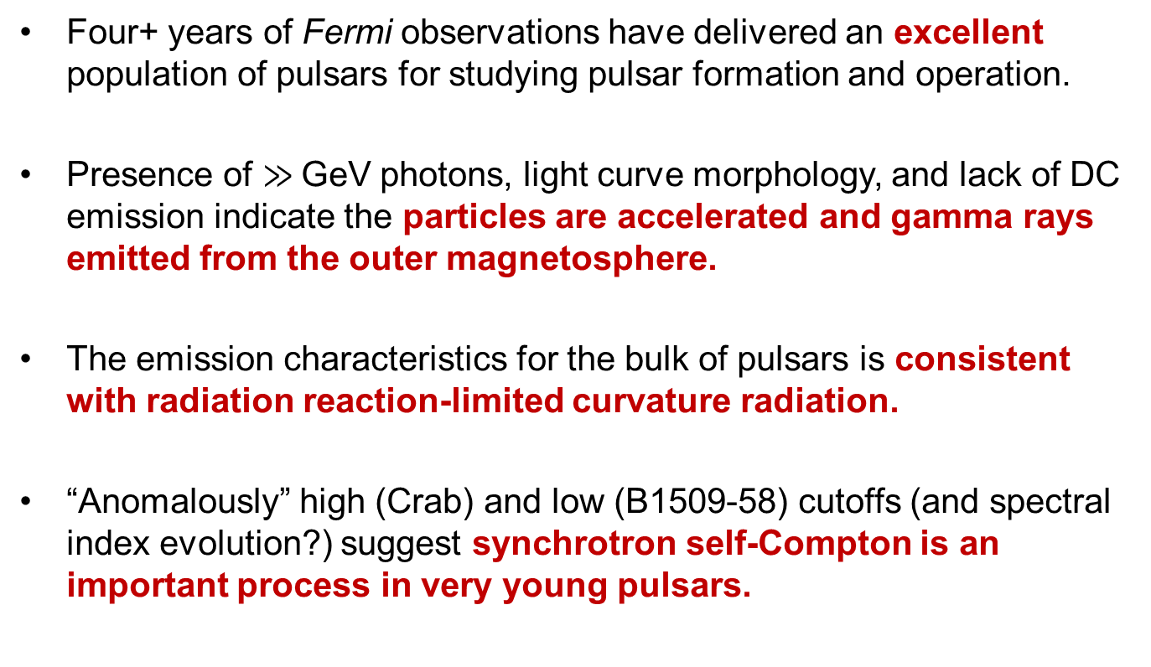
Summary
Four+ years of Fermi observations have delivered an excellent population of pulsars for studying pulsar formation and operation.
Presence of $≫$GeV photons, light curve morphology, and lack of DC emission indicate the particles are accelerated and gamma rays emitted from the outer magnetosphere.
The emission characteristics for the bulk of pulsars is consistent with radiation reaction-limited curvature radiation.
“Anomalously” high (Crab) and low (B1509-58) cutoffs (and spectral index evolution?) suggest synchrotron self-Compton is an important process in very young pulsars.
Thanks to the organizers for the opportunity to speak,
and for arranging such a nice conference!

