Slide 1


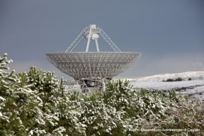
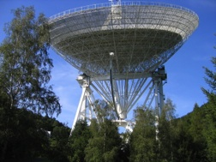
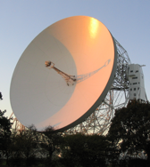
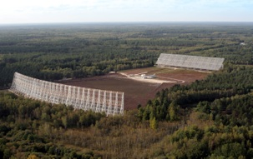
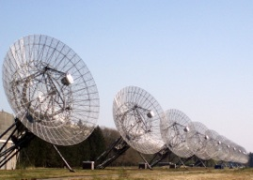
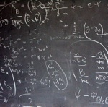
Update of the European Pulsar Timing Array
Kuo Liu, the EPTA collaboration
An array of 100-m class telescopes to form a pulsar timing array
SRT, Sardinia, Italy
Lovell, Jodrell Bank
UK
Effelsberg 100-m, Germany
NRT, Nançay, France
WSRT, Westerbork, NL
and ultimately forming the Large European Array for Pulsars (LEAP)

Slide 2
Outline
• The collaboration
• The instruments
• The results
• Summary and future work

Slide 3
The EPTA partners
Mission: “Perform high precision pulsar timing to detect gravitational
waves and study theories of gravity”
Observational efforts:
Max-Planck-Institute for Radioastronomy (MPIfR), Bonn, Germany
Jodrell Bank Centre for Astrophysics, Uni. Manchester, U.K.
ASTRON, the Netherlands
CNRS & Paris Observatory, France
INAF, Italy
Complemented by strong theoretical efforts by these members:
Albert Einstein Institute, Germany: limits, detection methods,
background prediction
MPIfR, Germany: sources, detection & observing strategies,
tests of theories of gravity
Uni. of Birmingham, U.K.: sources, black hole properties
Uni. of Manchester, U.K.: cosmic strings
http://www.epta.eu.org

Slide 4
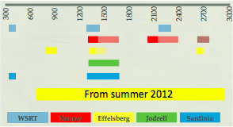
The EPTA observing systems
Observational advantages by having access to multiple telescopes:
Increased cadence and source coverage, no gap in data
- about 30 to 50 sources being monitored
- Cadence per source: 7d (Nancay), 10d (Jodrell) to 30d (WSRT, EFF)
- Time per source: 30-60min
Increased frequency coverage to monitor interstellar effect
Inherit error checking (clock jumps, instrumental instability…),
and reduction of systematics
Confirmation of detected events by comparing different telescope
data
Long time baseline: archives going back up to 25 years
MHz

Slide 5
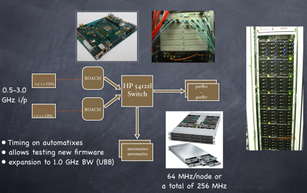
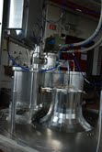
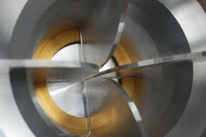
The EPTA observing systems
Effelsberg 100-m telescope:
Legacy Effelsberg-Berkeley Pulsar Processor (EBPP), up to 112 MHz on-line coherent
dedispersed BW, 4 bits
Incoherent programmable FFT spectrometers, up to 2 GHz BW, 32 bits
ASTERIX: Roach-board system for online coherent dedispersion, currently 200 MHz,
soon 1000 MHz BW, 8 bits
Ultra-broad band receiver (cooled), “BEACON” Project funded as 1.8M EUR, 600-
3000 MHz, whole BW digitally sampled at once (being tested)
GPU-based on-line coherent dedisperser, 2.5 GHz BW, 8 bits (being built)

Slide 6
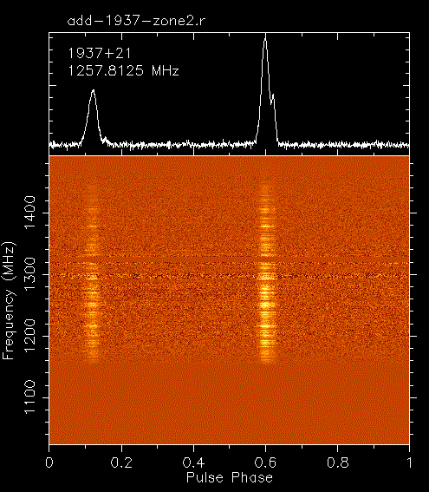
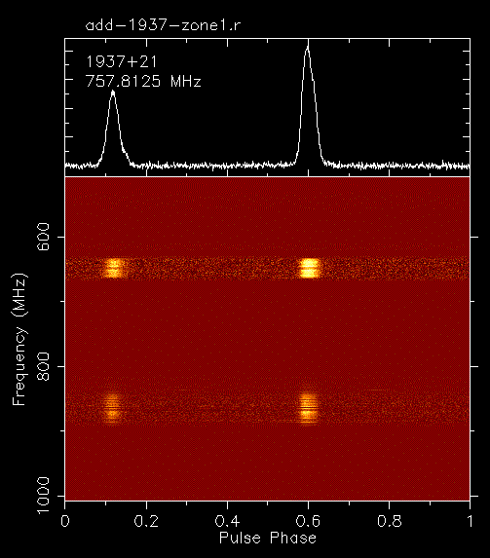
The EPTA observing systems
First light of the Ultra-broad band receiver!
Possible RFI components:
1 Digital TV stations
2 GSM band (cell phone)
3 GPS band
4 Internal source (?)
20-25 K system temperature expected after RFI excursion!

Slide 7
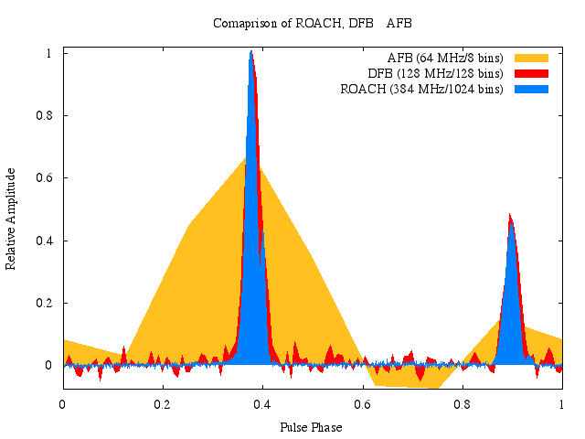


The EPTA observing systems
Lovell 76-m telescope, Jodrell Bank:
Legacy incoherent Filterbank system, up to about 100 MHz (up to 28 yrs data!)
ATNF Digital Filterbank (DFB), incoherent dedispersion, 384 MHz, BW, 8 bits
ASTERIX-like ROACH-board system, 400 MHz BW
8 bits, online coherent dedisperser, baseband
RFI rejection
HPC computing cluster for ROACH and LEAP
processing
32 node cluster
512 MHz
ROACH
32 x
16 MHz
10-1g switch

Slide 8
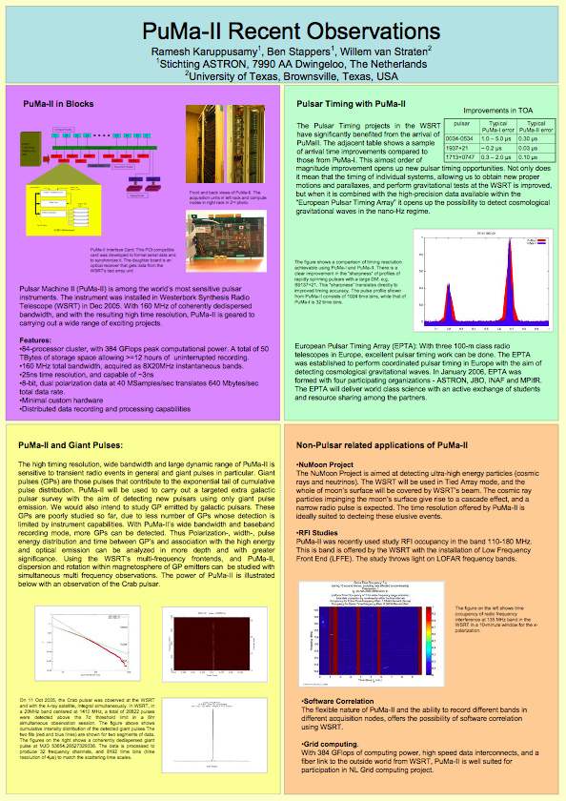
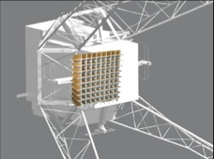
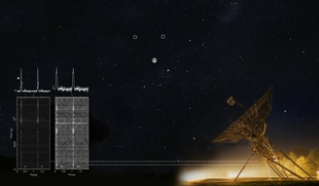
The EPTA observing systems
Westerbork Radio Synthesis Telescope, 94-m equivalent:
PuMaII baseband recorder for offline coherent dedispersion, 80 (<1 GHz) /160
MHz (>1 GHz) BW, 8 bits (since 2006)
Mulit-frequency frontends, observe from 300 - 2.3 GHz
Over next couple of years moving to APERTIF: PAF w/36 beams, >300 MHz BW,
~800-1600 MHz, overall slight improvement in sensitivity, but no freq. agility
van Leeuwen & Hessels

Slide 9
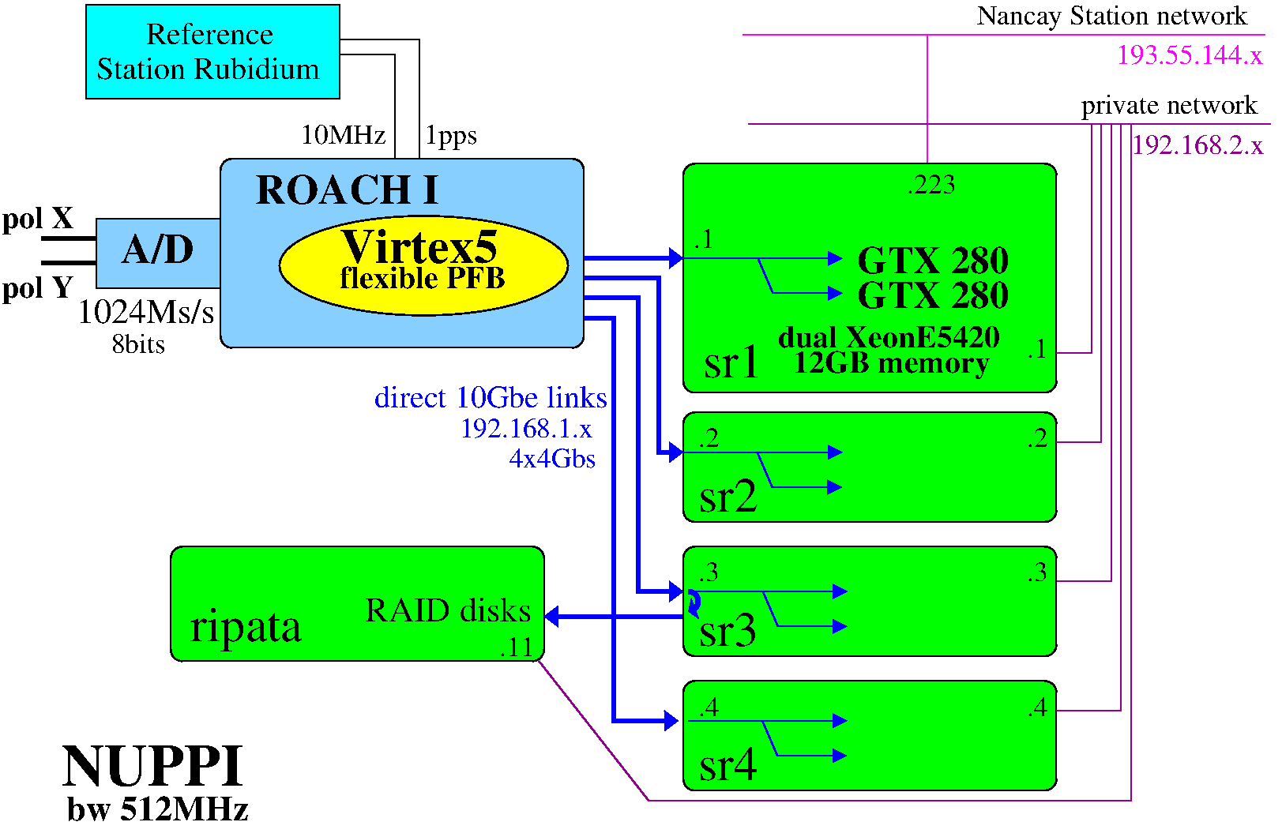
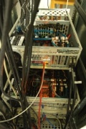
The EPTA observing systems
Nançay Radio Telescope, 94-m equivalent:
Berkeley-Orleans-Nancay (BON) online coherent dedisperser, SERENDIP V + GPU
based system, 128 MHz BW, 8 bits + software search mode
BON512 online coherent dedisperser, ROACH + GPU based system, 512 MHz BW, 8
bits + flexible digital search modes (incoherent and coherent)

Slide 10
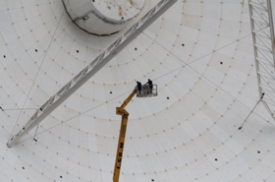
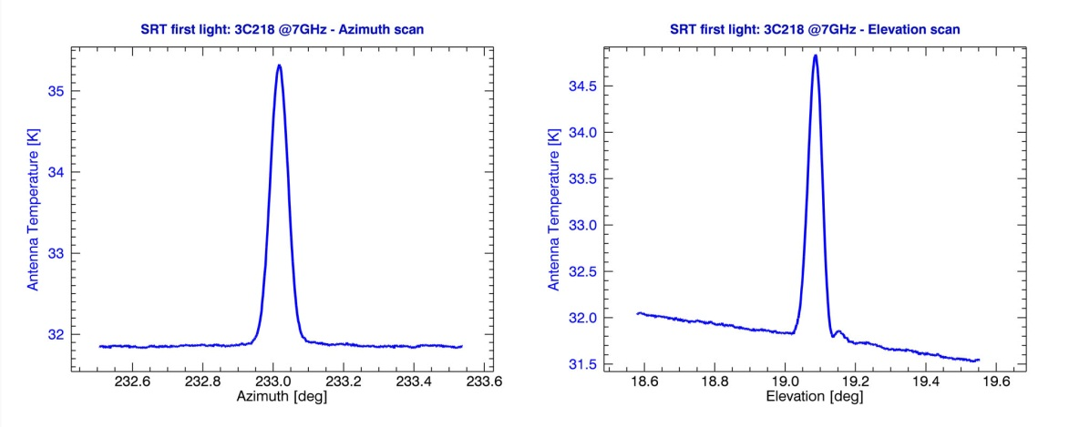
The EPTA observing systems
Sardinia Radio Telescope, 64-m (from Q4 2012):
Dual band ATNF Pulsar Digital Filterbank up to 500 MHz BW, 8 bits
Telescope being commissioned: smaller collecting area but only active surface
telescope in EPTA
H-maser arrived in July, tested and working!
First light 7 GHz receiver on second half of July and
the beginning of August
Tests DFB with PSRs at 7 GHz in mid-September
First light L-P band receiver (now in Medicina) at the end of November
Test DFB (folding mode) with L-P from then till Christmas
Baseband mode with DFB when the computational power on-site (likely dec/jan)
ASTERIX-like system in 2013

Slide 11
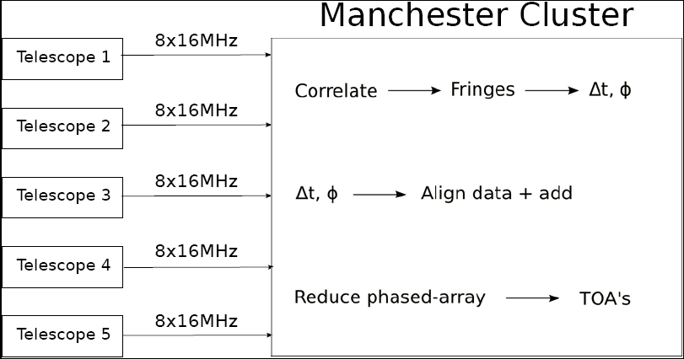
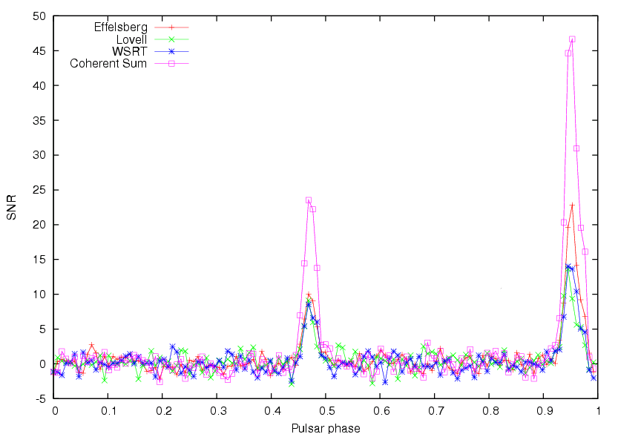
The EPTA observing systems
The Large European Array for Pulsars (LEAP), 194-m equivalent:
Instruments (backend baseband mode, storage machines, reduction cluster) ready
24 hours observational sessions among JB, EFF and WSRT (NRT involved for a few
hours) have been done for several epoches
Correlation pipleline finished and being
optimized, fully coherent summation
succeeded among three sides!
Polarisation calibration being investigated
NRT data also to be added
Timing database being constructed

Slide 12
Datasets
Telescope | D(m) | Tsys | h/month | Dec(deg) | Freq
Effelsberg | 100 | 24 | 43 | >-30 | 1.4, 2.6
Lovell | 76 | 30 | 50 | >-35 | 1.4
Nançay | 94 | 35 | 150 | >-39 | 1.4, 2.1
Sardinia | 64 | 25 | ? | >-46 | 0.3 simult 1.4
WSRT | 96 | 29 | 48 | >-30 | 0.35, 1.4, 2.3
LEAP | 194 | 30 | 24 | >-39 | 1.4
Pulsar | Eff(EBPP) | Eff(Asterix) | Jodrell(dfb) | Jodrell(R) | Nancay | WSRT(p1) | WSRT(PII)
0613-0200 | 2.0us(12yr) |  | 3.5us(3.3yr) |  | 1.1(7yr) | 2.3us (11yr) | 1.0us(5yr)
1022+1001 | 2.8us(15yr) |  | 2.0us(3.3yr) |  | 1.7(7yr) | 1.6us(11yr) | 1.0us(5yr)
1713+0747 | 0.5us(16yr) | 0.17 (1 yr) | 0.6us(3.3yr) | 0.200 (1.2yr) | 0.4(7yr) | 0.7us(11yr) | 0.23 us (5yr)
1937+21 | 0.23us(2yr) |  | 1.4us(3.3yr) | 0.33(1.2yr) |  | 0.8us*(10yr) | 0.5us(5yr)
1909-3744 | - |  | - |  | 0.11(7yr) | - | -

Slide 13
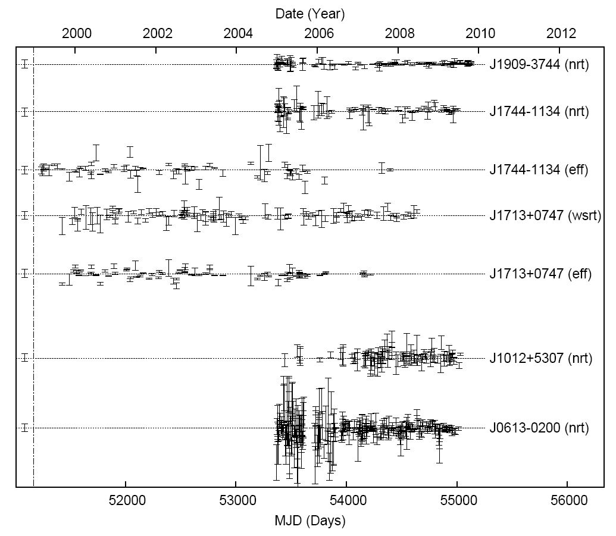
EPTA limit on gravitational wave background
Van Haasteren et al. 2011
Selected datasets from multiple telescopes and multiple pulsars for limiting the stochastic
gravitational wave background (GWB). Pulsars are chosen by considering the GW limits they
place individually. These five pulsars can individually constrain the GWB well below hc(1yr) =
10⁻¹³ for α = −2/3. The others are sufficiently worse so that they do not improve the limit
significantly.

Slide 14
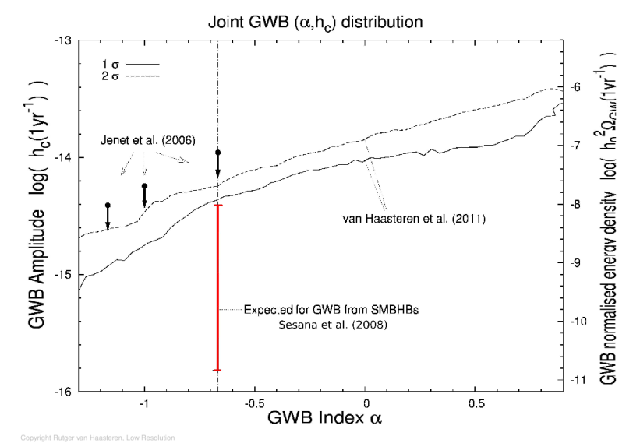
EPTA limit on gravitational wave background
Van Haasteren et al. 2011
The marginalised posterior distribution from Bayesian analysis as a function of the GWB
amplitude and spectral index. For the case α = −2/3, which is expected if the GWB is
produced by supermassive black hole binaries, we obtain a 95% confidence upper limit on A
of 6 × 10⁻¹⁵, which is 1.8 times lower than the 95% confidence GWB limit obtained by the
PPTA in 2006. The limit is already very close to probe into the GWB parameter space
predicted by Sesana et al. 2008.

Slide 15
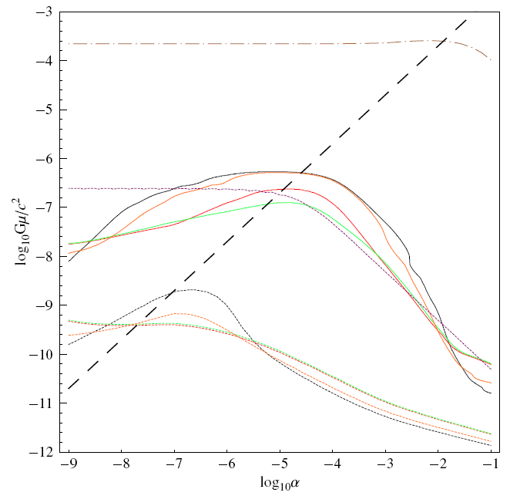
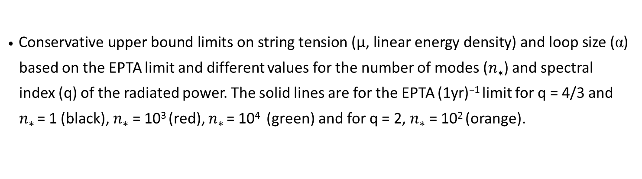
Constrains on cosmic string properties
Sanidas, Battye & Stappers, 2012
Conservative upper bound limits on string tension (μ, linear energy density) and loop size (α)
based on the EPTA limit and different values for the number of modes ($n_{∗}$) and spectral
index (q) of the radiated power. The solid lines are for the EPTA (1yr)⁻¹ limit for q = 4/3 and
$n_{∗}$ = 1 (black), $n_{∗}$= 10³ (red), $n_{∗}$ = 10⁴ (green) and for q = 2, $n_{∗}$= 10² (orange).
LIGO limit
Current EPTA
LEAP

Slide 16
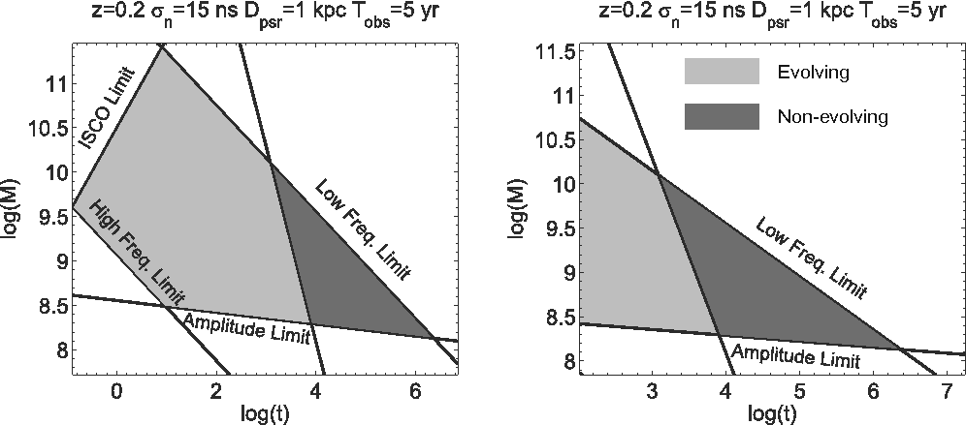
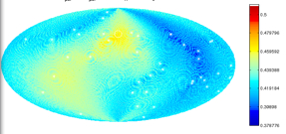
GW Single Source detection
Lee et al. 2011
Investigate the potential of detecting GWs from individual binary black hole systems using
PTAs
Calculate the accuracy for determining the GW properties
Accounting for the measurement of the pulsar distances via the timing parallax.
At low redshift, a PTA is able to detect nano-Hertz GWs from SMBHBs with masses of ∼ 10⁸ −
10¹⁰ M⊙ less than ∼ 10⁵ years before the final merger.
Binaries > ∼ 10³ − 10⁴ yrs before merger - effectively monochromatic GW emitters
Such binaries may also allow us to detect the evolution of binaries.
Also show how one can constrain distances
The parameter space of SMBHBs as detectable GW sources for a PTA
Constraining the GW source position
chirp mass of the SMBHB
‘present to the final merger in years

Slide 17
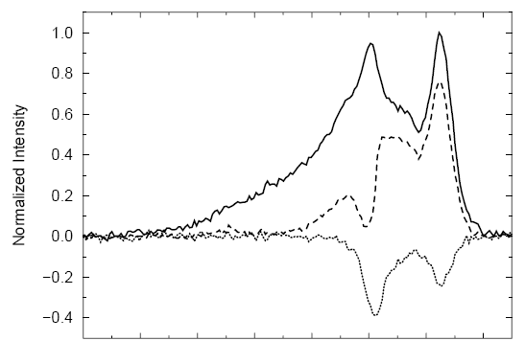
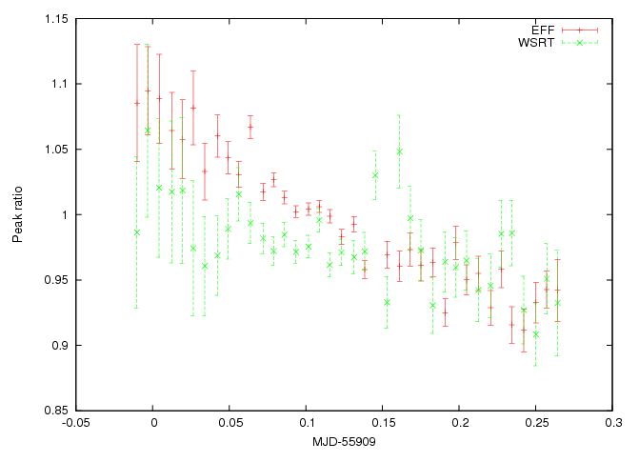
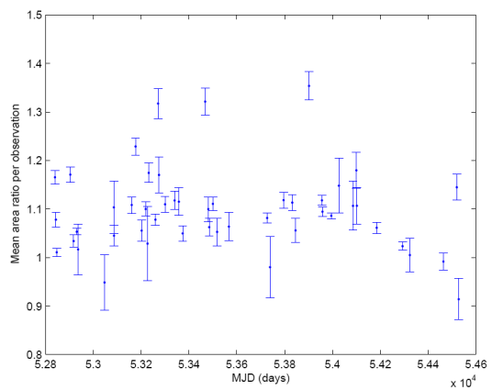
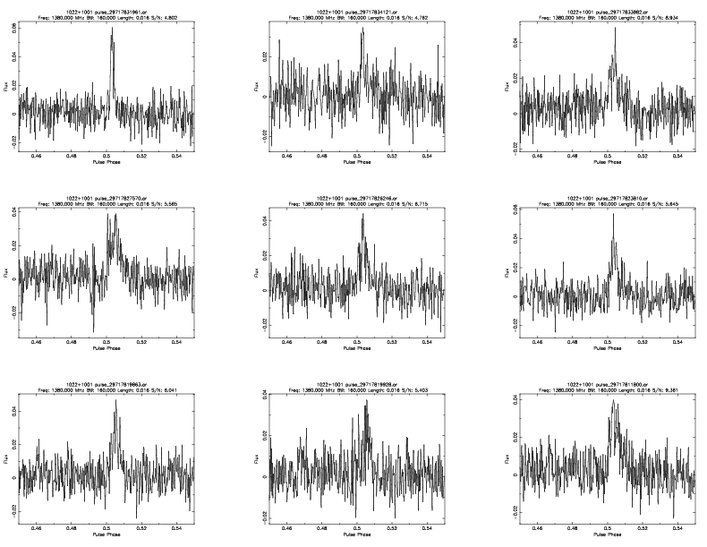
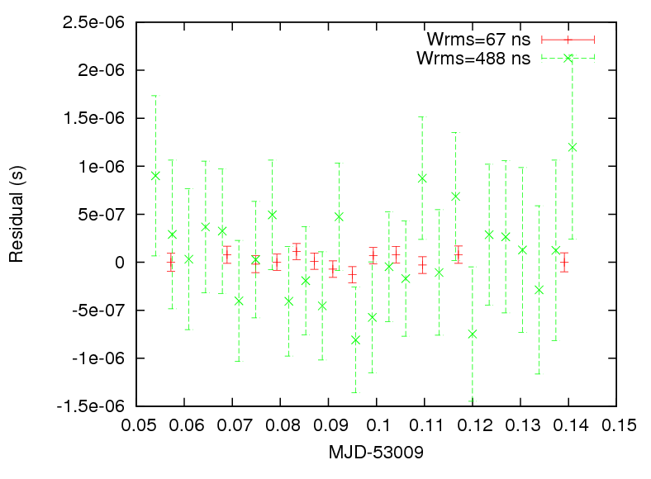
Profile Variations: J1022+1001
Liu, Purver et al 2012
Claims and counterclaims of profile evolution as function of time (Kramer et al 1999,
Ramachandran & Kramer 2003, Hotan et al. 2004), perhaps related
to polarisation calibration schemes
New observations detected profile variation both on short and long
timescale:
Single pulses detected at the trailing component, confirm indication by Edwards & Stappers
2003; possible improvement (factor of nearly 3!) on timing precision by using the single
pulses only!

Slide 18
Work in the past and future…
Others done:
Detecting massive graviton and alternative gravities via PTA (Lee et al. 2010, Lee’s talk on Thursday)
Prediction of the GWB background by supermassive black hole binaries (Sesana & Vecchio 2010)
MSP Profile stability and timing limit (Liu et al. 2011, 2012)
Measuring black hole properties via PTA single source detection (Sesana et al. 2011, Mingarelli et al. 2012)
Optimising observing strategy (Lee et al. 2012)
Stringent constrain on alternative gravities (Preire et al. 2012, Kramer’s talk on Thursday, Shao’s poster)
Being conducted:
Legacy dataset release in a few months including papers on timing solutions, DM variations, profile
variations (Janssen et al., Caballero et al., Desvignes et al.)
EPTA timing database and GWB detection pipeline with software library (Lazarus et al., Lassus’ poster)
Combining the multiple-site datasets for the IPTA (Janssen et al.)
Completion of full operational mode for LEAP (Bassa et al.)
APERTIF being installed at WSRT starting 2013
Full installation of Ultra-broad receiver (UBB) at Effelsberg
LOFAR (core + single-station) timing of MSPs: 48/80 MHz BW @ 110-240 MHz
SRT observations to commence in Q1/2013 – access to 100 MHz @ 300 MHz
Relativistic spin precession of PSR J1906+0746 (Desvignes’ talk on Thursday)

Slide 19
















Thanks for your attention & enjoy Chinese food in Beijing!!^_^

