Slide 1

IAUS291＠Beijing
24 Aug 2012
The Structure
of
the Pulsar
Magnetosphere
via Particle Simulation with GRAPE
Shinpei Shibata
柴田 晋平
Yamagata Univ.山形大学
Department of Phys 物理学科

Slide 2
IAUS291＠Beijing
24 Aug 2012
Collaborators
T. Wada (NAOJ)
S. Yuki (Yamagata U.)
M. Umizaki (Yamagata U.)

Slide 3
Summary of our Particle Simulation
1. The outer gap can be reproduced under a few simple assumptions.
2. Centrifugal driven particle acceleration at the top of the closed field region (Y-point) is suggested. E-perp effect.
3. Dead zones along separatrix of the oppositely- directed current is found. PC and SG locate above it and OG below it.
For detail, see
Wada, T., Shibata, S., 2011, MNRAS, 418, 612
Wada, T., Shibata, S., 2007, MNRAS, 376, 1460
Umizaki, M., Shibata, S., 2010, PASJ, 62, 131
Yuki, S., Shibata, S., 2012, PASJ, 64, 43

Slide 4
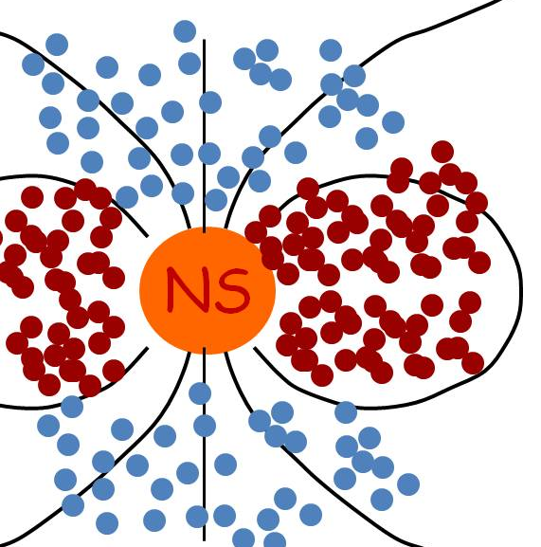
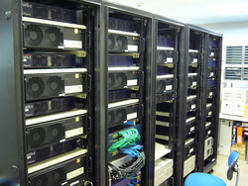
1. The outer gap can be reproduced under a few simple assumptions.
(i)The system is axis-symmetric,
60RL
60RL
Plasmas are represented by several tens of thousands of super-particles.
Cal .Domain is 3D (60RL)^3
60RL
GRAPE-6@nao.jp
Special purpose computer for
Astronomical N-body Problem
We iteratively solve the equation of mo. and EM field until steady state is settled down.

Slide 5

1. The outer gap can be reproduced under a few simple assumptions. (cont.)
(ii) rel. eq. mo. for super particles with radiation drag force.
(m, q) are chosen so that any plasma drift motions are tracked correctly. dt<< gyro-period
Radiation drag force is taken into account in the lowest order approximation.
path
Radiation
Drag force
Curvature
radiation
B-field line

Slide 6
1. The outer gap can be reproduced under a few simple assumptions. (cont.)
(iii) Plasma sources are provided for
- free emission from NS surface
- pair creation if E// > Ec. (on the spot approx.)
model parameter
Electric field
B
γ＋X-ray ➔e+ ＋ e-
γ＋B ➔e+ ＋ e-
magnetic pair creation
Two photon pair creation
That’s all!!!

Slide 7
1. The outer gap can be reproduced under a few simple assumptions. (cont.)
(*) Central magnet is rotating : i.e. voltage on NS
BC. on NS surface is strictly satisfied, because we use the Green function satisfying the boundary condition to obtain the electromagnetic field.

Slide 8
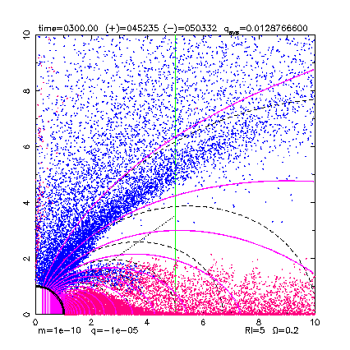
outer gap
light cylinder
Pairs are continuously produced.
Pairs are immediately separated by the field-aligned electric field.

Slide 9
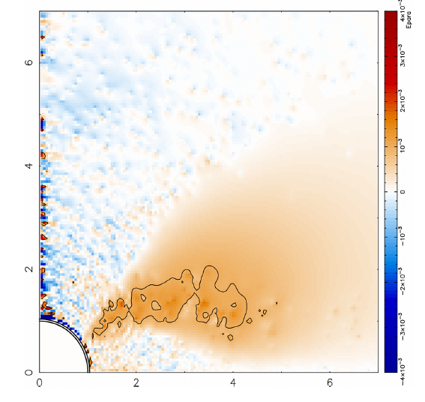
E// map
Because we have plasma sources, E// is screened out everywhere, except for the outer gap where E// is just above Ec: necessary minimum for pair creation.

Slide 10
2. Centrifugal driven particle acceleration at the top of the closed field region (Y-point). E-perp effect.
This outflow is essentially due to strong induction of rotation, (corotation), i.e., E-perp, more basically emf
light cylinder
Open magnetic flux
toroidal speed is high, radiation carries off angular momentum from the magnetosphere. Back reaction causes drift across the magnetic field to make out flow.
Notes:
The second topic is about this region, dashed oval, at the top of the closed field region.
In this region, toroidal speed, perpendicular to this plane, is very much high, and radiation carries off angular momentum from the magnetosphere. Back reaction causes drift across the magnetic field to make outflow.
This outflow is essentially due to strong induction of rotation, strong tendency of corotation, namely due to the perpendicular electric field, more basically the electromotive force of the NS.
The poloidal current stats from the star, run through the outer gap and to go infinity.
The return current comes from infinity to the polar cap.
Due to this current, the mazenda curves shows that we have open magnetic flux, along which pairs escape from the system.

Slide 11
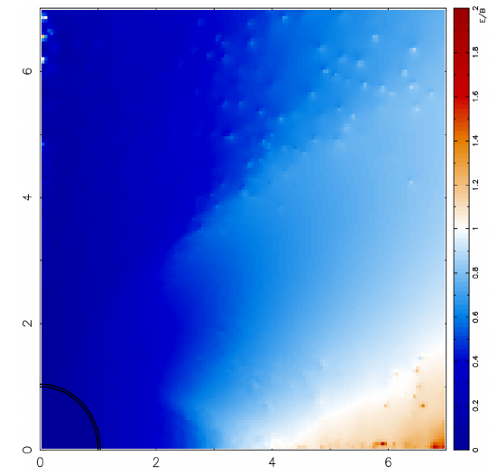
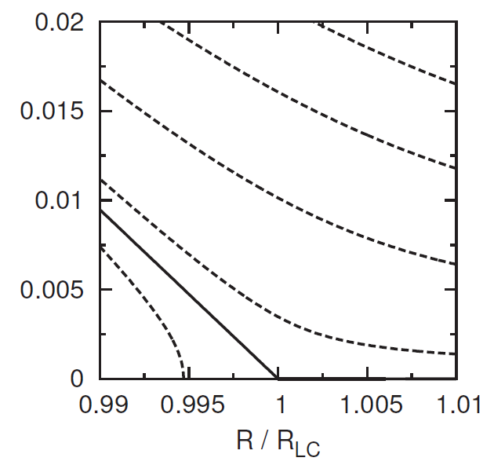

2. Centrifugal driven particle acceleration at the top of the closed field region (Y-point). E-perp effect. (cont.)
Map of E/B
Force-free Udzdenski sol.
light cylinder
（Uzdensky, 2003）
Notes:
The top of the closed field region is interesting because of another reason.
This left one shows the force-free semi-analytic solution by Uzdensky, and in the red region the electric field is larger than the magnetic region. This phenomena is also found in our simulation. In this region, electrically driven particle jet can be expected.

Slide 12
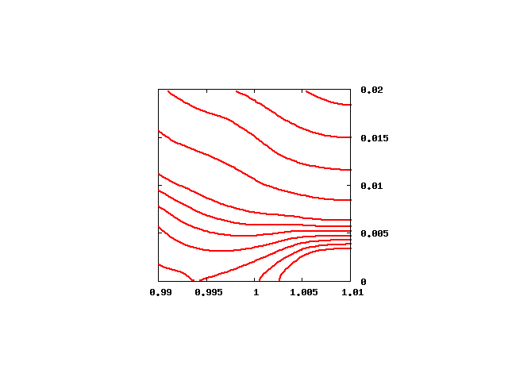
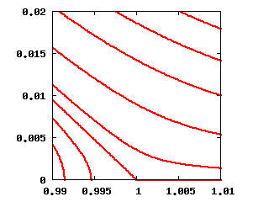
2. Centrifugal driven particle acceleration at the top of the closed field region (Y-point). E⊥ effect. (cont.)
centrifugal driven reconnection at the top of the closed field region
2-D cylindrical PIC simulation for Y-point.
t ～ 4 x 10^5 ⊿ t
0.02
0.02
Z / R_{LC}
Z / R_{LC}
0.01
0.01
0.00
0.00
Initial state
（Uzdensky, 2003）
0.99
1.00
1.01
R / R_{LC}
Magnetic reconnection takes place
⇒ heating and acceleretion
Notes:
I would like to point out another possiblity that is centrifugal driven reconnection at the top of the closed field region.
This is the result of our 2-D cylindrical PIC simulation.

Slide 13
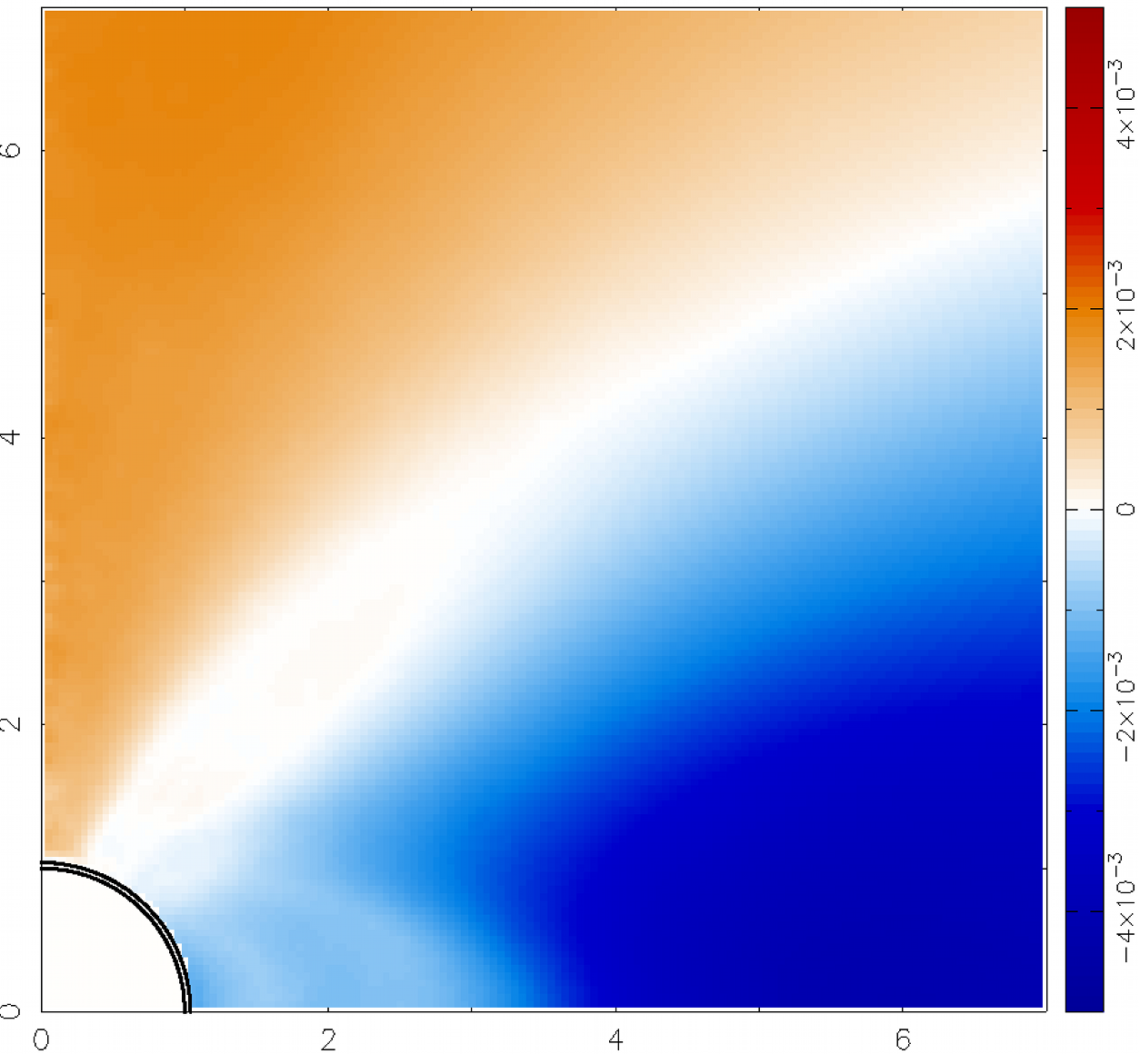
3. Dead zones along separatrix of the current is found. OG, PC locate above it and SG below it.
We find another dead zone in the middle latitudes.
This dead zone locates on the field lines which separates the outgoing current and ingoing current.
Let us call this zone the current neutral dead zone.
Map of Non-corotational electric potential
Dead zone
after Yuki, S., Shibata, S., 2012, PASJ, 64, 43
Notes:
The last point can be seen in the plot of non-corotational electric potential. The white regions have no potential difference from the NS surface along the magnetic field, so no acceleration and no flow there. The white regions may be called the dead zone. The closed field region is the traditional dead zone.
We find another dead zone in the middle latitudes.
This dead zone locates on the field lines which separates the outgoing current and ingoing current.
Let us call this zone the current neutral dead zone.

Slide 14
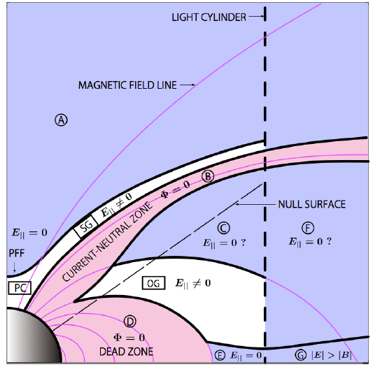
3. Dead zones along separatrix of the current is found. OG, PC locate above it and SG below it. (cont.)
The outer gap is sandwiched by two dead zones. Therefore, the boundary conditions used previously in the outer gap is correct.
The polar cap and the slot gap would be above the current neutral dead zone.
after Yuki, S., Shibata, S., 2012, PASJ, 64, 43
Notes:
The outer gap is sandwiched by two dead zones.
The polar cap and the slot gap would be located above the current neutral dead zone.

Slide 15
Summary of Particle Simulation
1. The outer gap can be reproduced under a few simple assumptions.
2. Centrifugal driven particle acceleration at the top of the closed field region (Y-point) is suggested. E-pep effect. Magnetic reconnection.
3. Dead zones along separatrix of the current is found. PC and SG locate above it and OG below it.
Strong emf + limited source of plasma
A New source of radiation,
Fall back particles on to PC,
Mode changing etc,,,,,
For detail, see
Wada, T., Shibata, S., 2011, MNRAS, 418, 612
Wada, T., Shibata, S., 2007, MNRAS, 376, 1460
Umizaki, M., Shibata, S., 2010, PASJ, 62, 131
Yuki, S., Shibata, S., 2012, PASJ, 64, 43

Slide 16
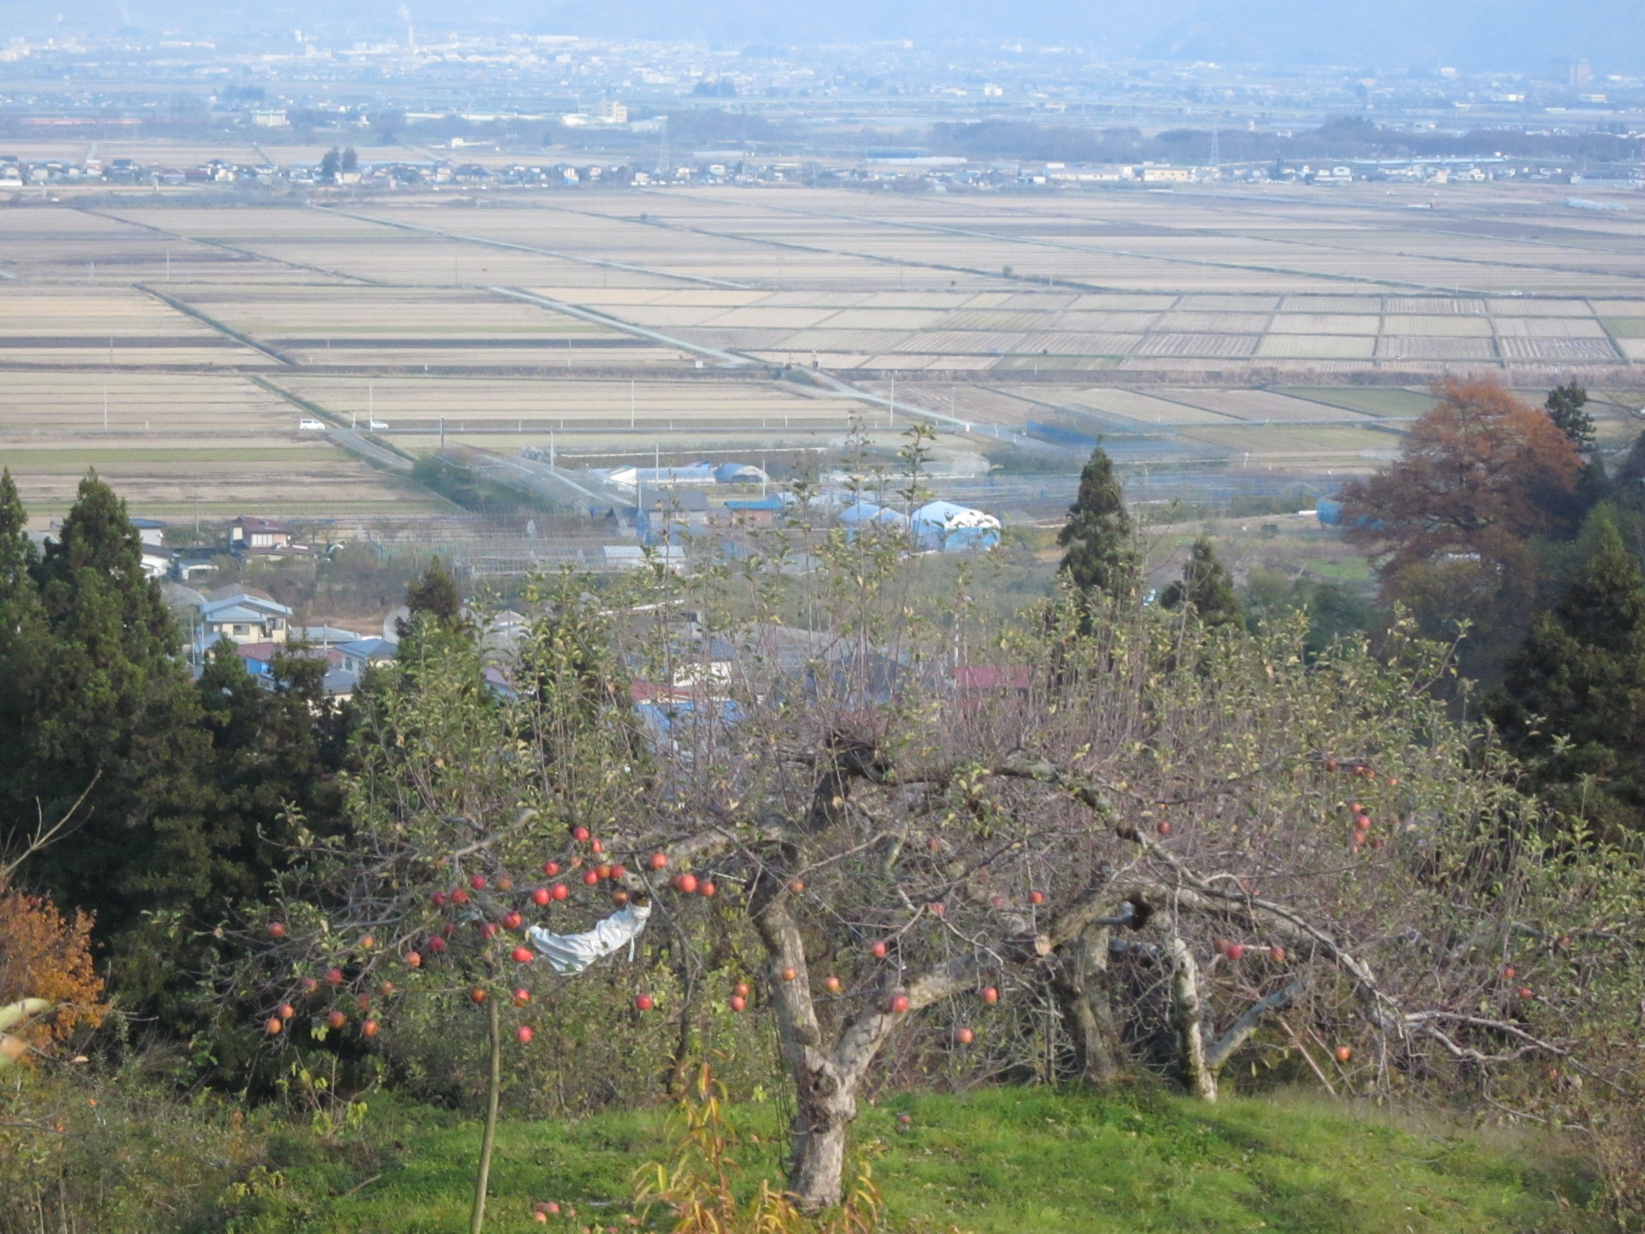
Thank you!

